Slide 1
CS145 Discussion
Week 2
Junheng, Shengming, Yunsheng
10/12/2018

Slide 2
Roadmap
Reminders
Review: Linear Regression
Examples question
Regularization
Z-score Normalization
Newton’s Method
Review: Logistic Regression
Example question
Log-likelihood
Q&A: Course Projects
Dataset
Some ideas
Programming Tips

Slide 3
Reminders
Homework 1 released on CCLE, due on 23:59 pm, Oct 19 (next Friday)
Programming questions about linear/logistic regression
Submit code and report together!
Course project released on Kaggle
Website: https://www.kaggle.com/c/yelpratingprediction
Team Sign-up: https://docs.google.com/spreadsheets/d/1psDqf4yTienkOrcI6vJd0BigHRlyCBlRjk6Uf7ki2-M/edit?usp=sharing
Important date: Nov.5 - Midterm report, Dec. 9 - Final report
Anyone still do not have a team?
Join Piazza!
https://piazza.com/ucla/fall2018/cs145/home

Slide 4
Linear Regression: Model
Linear model to predict value of a variable y using features x
Least Square Estimation
Closed form solution

Slide 5
Linear Regression: Example
A ball is rolled down a hallway and its position is recorded at five different times. Use the table shown below to calculate
Weights
Predicted position at each given time and at time 12 seconds
Time (s) | Position (m)
1 | 9
2 | 12
4 | 17
6 | 21
8 | 26

Slide 6
Linear Regression: Example
Step 1: Question
What are X and Y variables?
What are the parameters for our problem?
Calculating parameters
Time (s) | Position (m)
1 | 9
2 | 12
4 | 17
6 | 21
8 | 26

Slide 7
Linear Regression: Example
Step 1: Calculate Weights
What are X and Y variables?
Time (X) and Position(Y)
What are the parameters for our problem?
:Time :Intercept
Calculating parameters
Time (s) | Position (m)
1 | 9
2 | 12
4 | 17
6 | 21
8 | 26

Slide 8
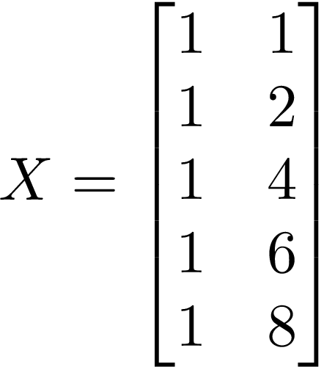
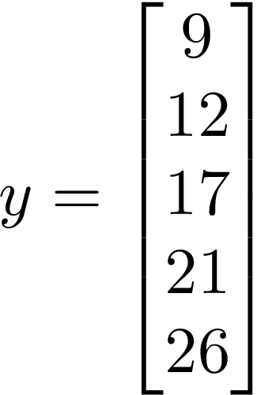
Linear Regression: Example
Let’s calculate on BOARD!
Time (s) | Position (m)
1 | 9
2 | 12
4 | 17
6 | 21
8 | 26

Slide 9
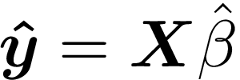
Linear Regression: Example
Step 2: Apply your model and predict
Plug time values into linear regression equation
Predicted value at time = 12 secs
Matrix form to predict all other positions
Time (s) | Position (m)
1 | 9
2 | 12
4 | 17
6 | 21
8 | 26
12 | 35.55

Slide 10
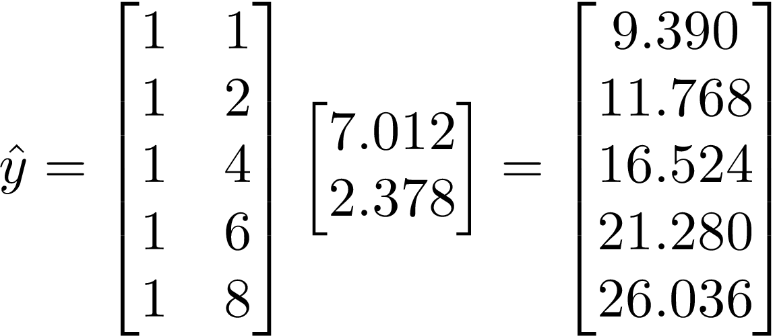
Linear Regression: Example
Plot: Check your model
Time (s) | Position (m)
1 | 9
2 | 12
4 | 17
6 | 21
8 | 26

Slide 11
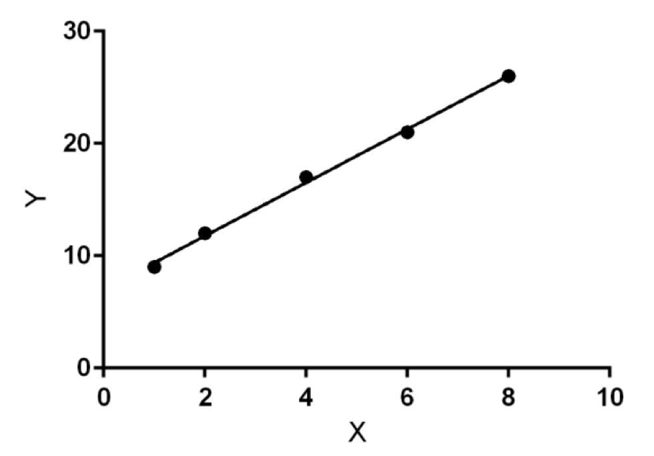
Linear Regression: Example
Plot: Check your model
Time (s) | Position (m)
1 | 9
2 | 12
4 | 17
6 | 21
8 | 26

Slide 12
Linear Regression + Regularization
Why do we need regularization?
Constraint the parameter values
Avoid overfitting phenomenon

Slide 13
Closed form: LR + Regularization
Prediction
Original Objective
L2-Regularized Objective

Slide 14
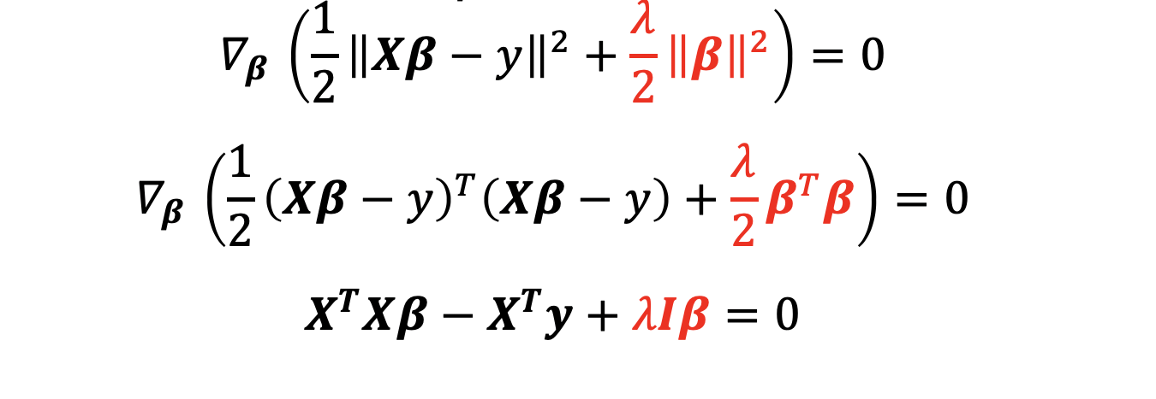
Closed form: LR + Regularization

Slide 15
Regularization
Regularization methods
L2 normalization (Ridge)
L1 normalization (Lasso)
Dropout (in neural networks)
Early Stopping

Slide 16
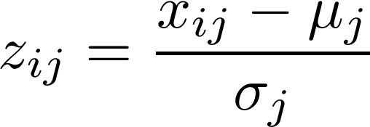
Z-Score Normalization
Why normalize features？
Different feature ranges such as [-1, 1] and [-100, 100] may negatively affect algorithm performance.
Thus, small change in bigger range can affect more than huge change in smaller range.
Calculate Z-Score (Standard Score)
→ the standard score for feature j of data point i
→ the value of feature j of data point i
→ the mean and standard deviation of feature j

Slide 17
Z-Score Normalization: Example
Galaxy | Distance (Mpc) | Velocity (km/sec)
Virgo | 15 | 1,600
Ursa Minor | 200 | 15,000
Corona Borealis | 290 | 24,000
Bootes | 520 | 40,000
How to Normalize feature “Distance”？

Slide 18
Z-Score Normalization: Example
Galaxy | Distance (Mpc) | Velocity (km/sec)
Virgo | 15 | 1,600
Ursa Minor | 200 | 15,000
Corona Borealis | 290 | 24,000
Bootes | 520 | 40,000
How to Normalize feature “Distance”？
Computer mean and deviation first

Slide 19
Z-Score Normalization: Example
Galaxy | Distance (Mpc) | Velocity (km/sec)
Virgo | 15 | 1,600
Ursa Minor | 200 | 15,000
Corona Borealis | 290 | 24,000
Bootes | 520 | 40,000
How to Normalize feature “Distance”?
Computer mean and deviation
Computer Z-Score for each sample

Slide 20
Z-Score Normalization: Example
Galaxy | Distance (Mpc) | Velocity (km/sec)
Virgo | 15 | 1,600
Ursa Minor | 200 | 15,000
Corona Borealis | 290 | 24,000
Bootes | 520 | 40,000
How to Normalize feature “Distance”?
Computer mean and deviation
Computer Z-Score for each sample (for example “Virgo”)

Slide 21
Newton’s Method
From lectures:
Apply Newton’s methods on single variable to find minima:
From single variable to Multivariate Newton-Raphson Method

Slide 22
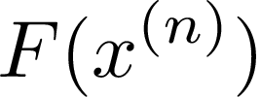
Newton’s Method: Steps
Initialize
Calculate
Calculate
Initialize step and start loops
Calculate
Calculate
Calculate
Update:
Update:
Exit Loop

Slide 23
Newton’s Method: Example
Again, let’s calculate on BOARD!

Slide 24
Newton’s Method: Solution
Newton’s Method
Example in one step:
Calculate
Calculate
Calculate
Update:
Update:

Slide 25
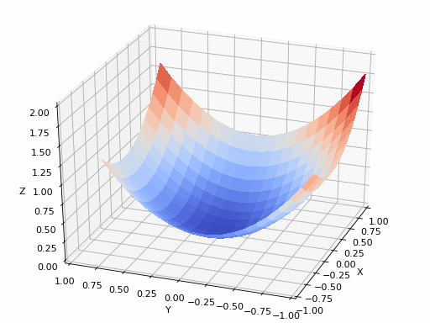
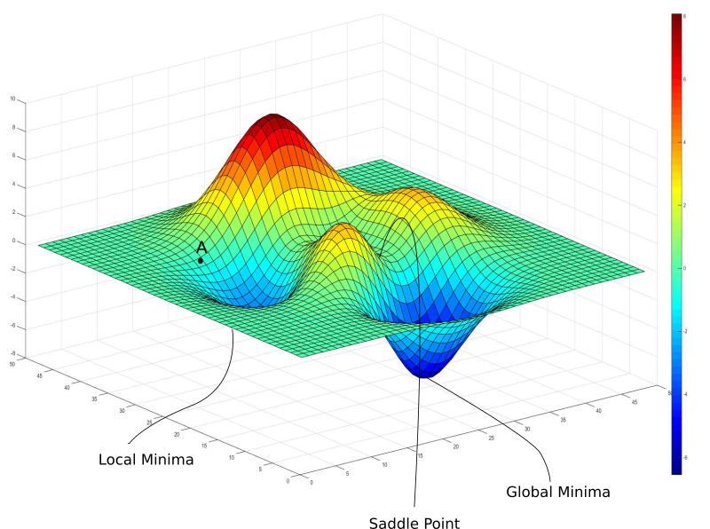
Gradient Descent

Slide 26
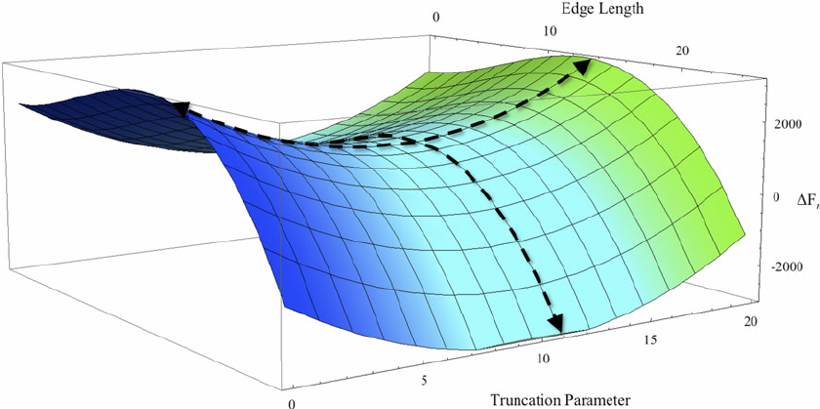
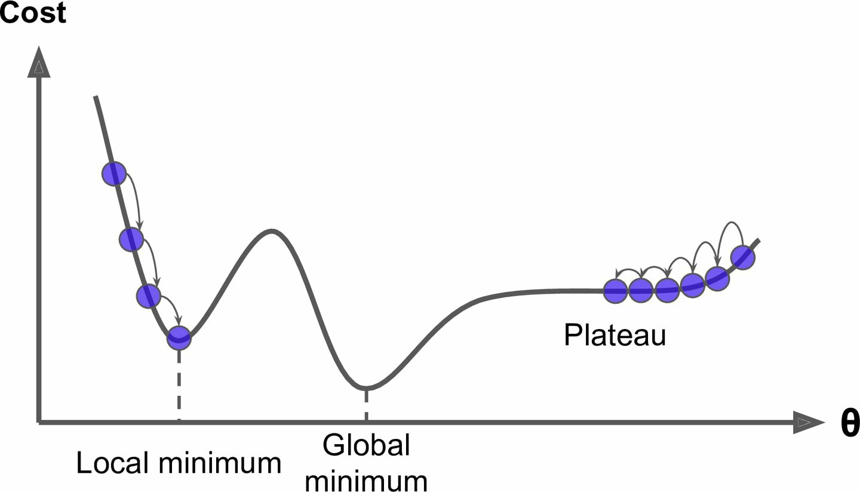
Gradient Descent: Batch vs Stochastic
Why do we need Stochastic GD besides the efficiency/scalability reason?
Think about saddle points and local minima.
https://blog.paperspace.com/intro-to-optimization-in-deep-learning-gradient-descent/
Géron, Aurélien. Hands-on machine learning with Scikit-Learn and TensorFlow: concepts, tools, and techniques to build intelligent systems. " O'Reilly Media, Inc.", 2017.

Slide 27
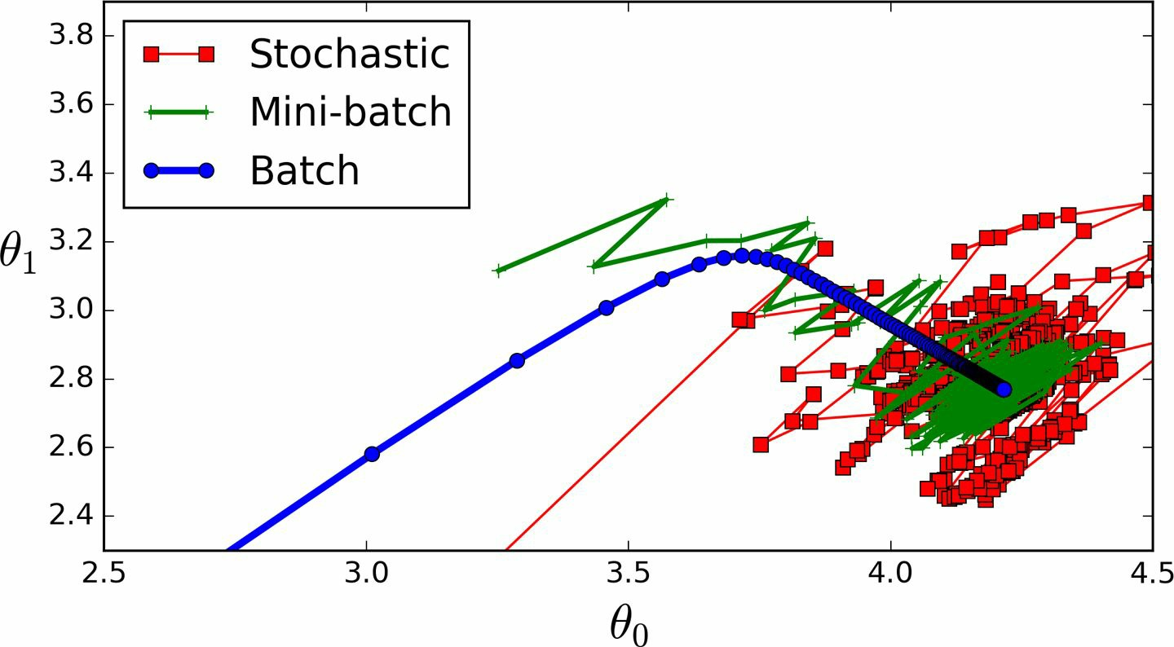
Comparison
Batch vs Stochastic vs Mini-batch

Slide 28
Gradient Descent or Newton’s Method?
https://stats.stackexchange.com/questions/253632/why-is-newtons-method-not-widely-used-in-machine-learning
https://math.stackexchange.com/questions/609680/newtons-method-intuition
https://thelaziestprogrammer.com/sharrington/math-of-machine-learning/solving-logreg-newtons-method
https://web.archive.org/web/20151122203025/http://www.cs.colostate.edu/~anderson/cs545/Lectures/week6day2/week6day2.pdf

Slide 29
Gradient Descent or Newton’s Method?
https://stats.stackexchange.com/questions/253632/why-is-newtons-method-not-widely-used-in-machine-learning
https://math.stackexchange.com/questions/609680/newtons-method-intuition
https://thelaziestprogrammer.com/sharrington/math-of-machine-learning/solving-logreg-newtons-method
https://web.archive.org/web/20151122203025/http://www.cs.colostate.edu/~anderson/cs545/Lectures/week6day2/week6day2.pdf

Slide 30
Logistic Regression: Example Question
We are given a data set consisting of the following experiment. Well, the dataset is a little bit small. (O_o)
The height and weight of 3 people were recorded at the beginning of each person’s 65th birthday. At exactly one year after each person’s 65th birthday the vital status was recorded to be either alive or deceased.
Our end goal is to use logistic regression to predict the probability that a person’s life expectancy is at least 66 years given their age of 65, initial vital status of alive, height, and weight (but we won’t go that far here).
The data is given in the following table on the right.
Height (inches) | Weight (lbs) | Vital Status
60 | 155 | Deceased
64 | 135 | Alive
73 | 170 | Alive

Slide 31
Logistic Regression: Example Question
Step 1: State the log-likelihood function.
Height (inches) | Weight (lbs) | Vital Status
60 | 155 | Deceased
64 | 135 | Alive
73 | 170 | Alive

Slide 32
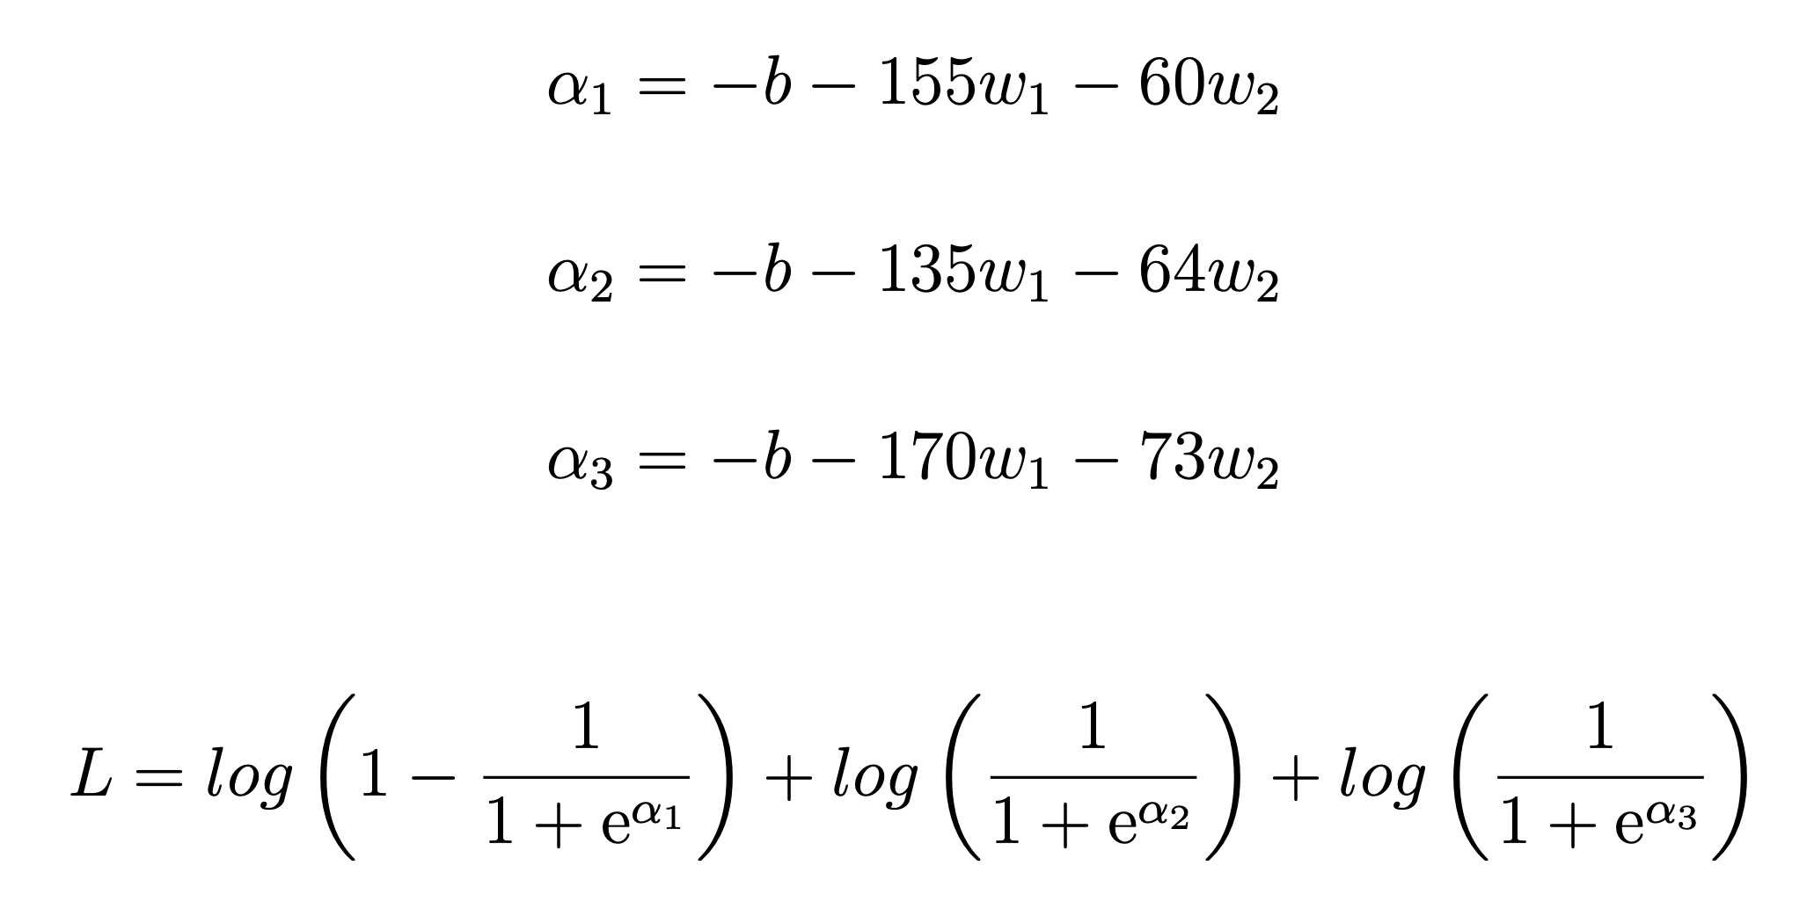
Logistic Regression: Example Question
Step 1: State the log-likelihood function.
Answer:
Height (inches) | Weight (lbs) | Vital Status
60 | 155 | Deceased
64 | 135 | Alive
73 | 170 | Alive

Slide 33
Logistic Regression: Example Question
Step 2: State the gradients for each parameter.
Height (inches) | Weight (lbs) | Vital Status
60 | 155 | Deceased
64 | 135 | Alive
73 | 170 | Alive

Slide 34
Logistic Regression: Example Question
Step 2: State the gradients for each parameter.
Answer:
Height (inches) | Weight (lbs) | Vital Status
60 | 155 | Deceased
64 | 135 | Alive
73 | 170 | Alive

Slide 35
Logistic Regression: Example Question
Step 3: Give the Hessian Matrix
Height (inches) | Weight (lbs) | Vital Status
60 | 155 | Deceased
64 | 135 | Alive
73 | 170 | Alive

Slide 36
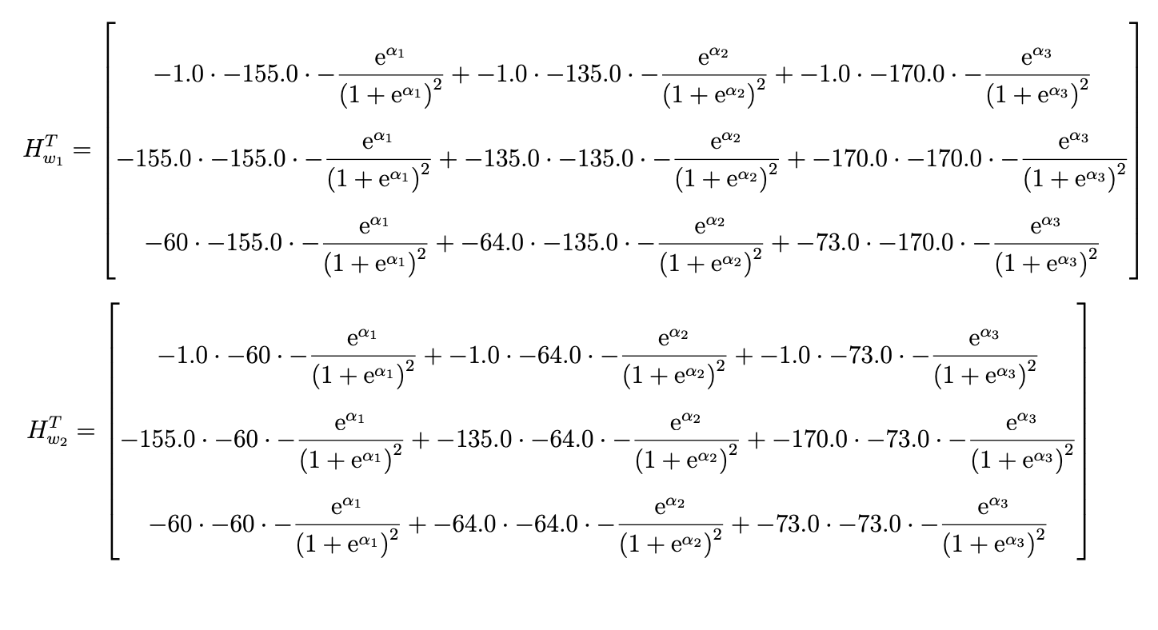
Logistic Regression: Example Question
Step 3: Give the Hessian Matrix

Slide 37
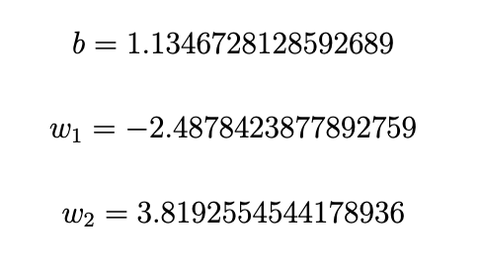
Logistic Regression: Example Question
Step 4: Assuming an initial guess of 0.25 for each parameter, write python code for finding the values of the parameters after 2 iterations using the Newton Raphson method.
Height (inches) | Weight (lbs) | Vital Status
60 | 155 | Deceased
64 | 135 | Alive
73 | 170 | Alive

Slide 38
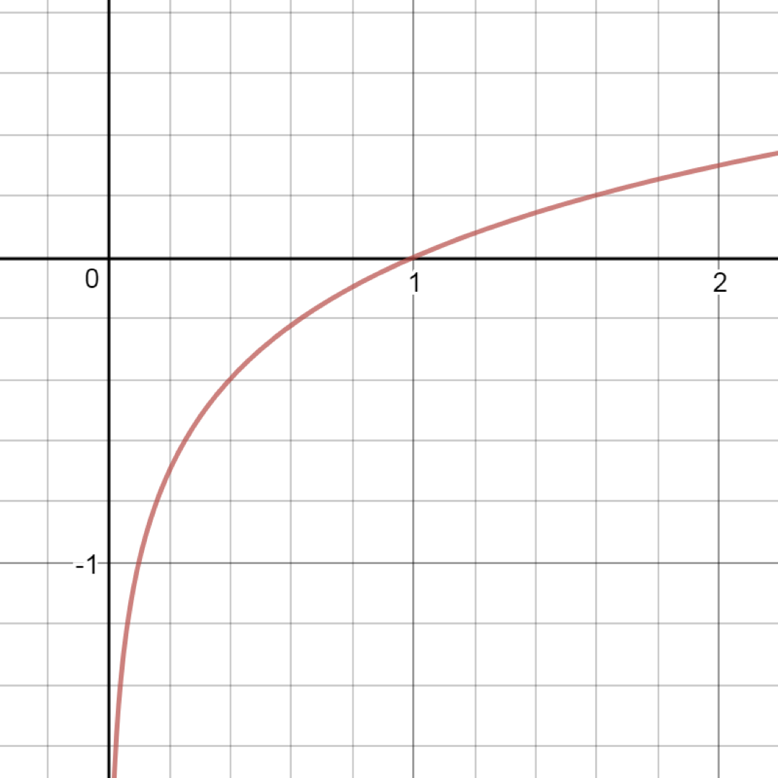
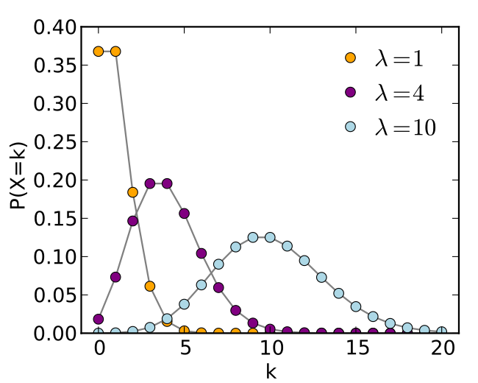
Notes on Log-likelihood
Logistic Regression
Is likelihood a density or probability?
No, it is the multiplication of densities
Log-likelihood used in gradient method
Logarithm is a strictly increasing function
Avoid product of probabilities underflow
Easier to take partial derivative than multiplication of probabilities
Examples → Maximum Likelihood on Poisson Distribution

Slide 39
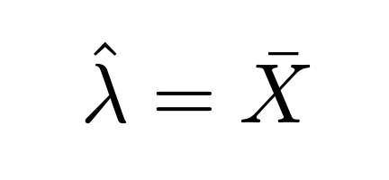
Notes on Log-likelihood
Logistic Regression
Is likelihood a density or probability?
No, it is the multiplication of densities
Log-likelihood used in gradient method
Logarithm is a strictly increasing function
Avoid product of probabilities underflow
Easier to take partial derivative than multiplication of probabilities
Examples → Maximum Likelihood on Poisson Distribution

Slide 40
Project: Help Yelp!
Course project contest on yelp rating prediction is launched on Kaggle.
Link: https://www.kaggle.com/c/yelpratingprediction
Important Dates
Today: Group Formation
Nov. 5: Midterm Report
Dec. 9: Final Report

Slide 41
Yelp Dataset
Friends
User
Review
Business
User ID
User ID
Business
ID
Friends
Location
Business
ID
Average stars
Review Stars
Attributes
Personal
Features
Review Text
Categories
Account Duration
Date
Average Stars
Review counts
Useful
Hours

Slide 42
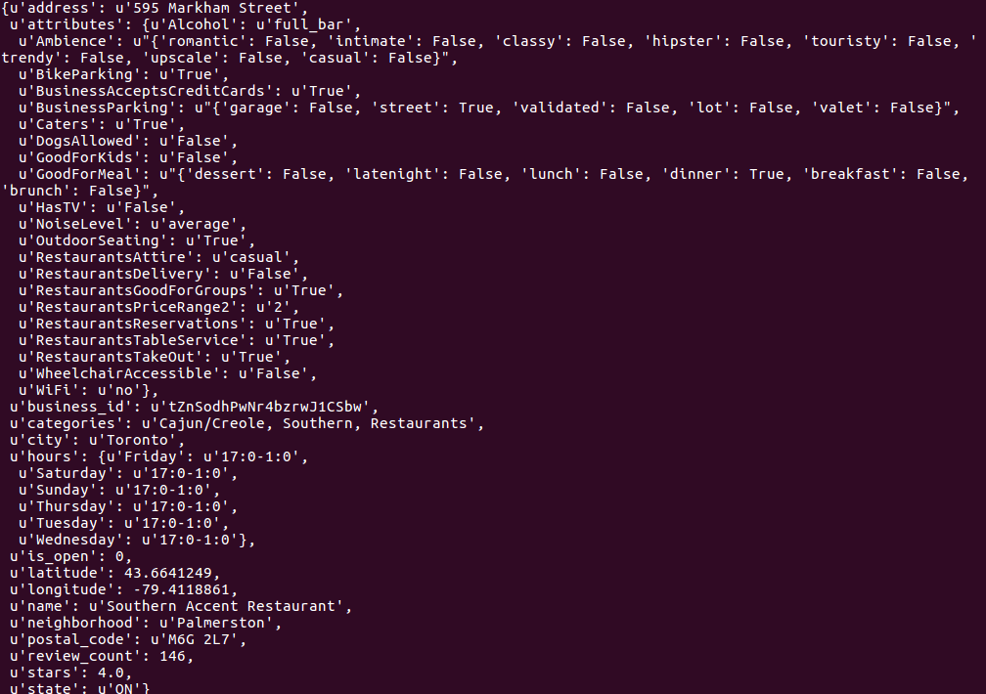
Business
Index
Features / Attributes (outdoor/is_romantic, etc)
Categories
Hours
Address (Street/Postal code/state)
Stars

Slide 43
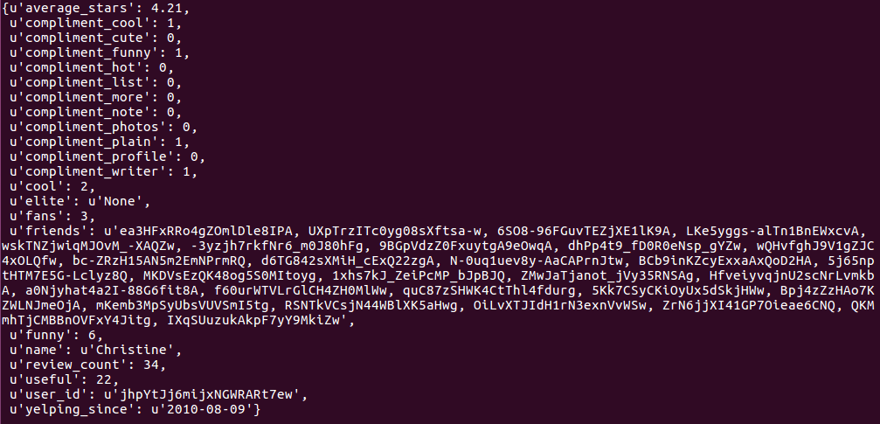
User
Index
Features
Fans
Is_cool
Useful score
etc
Review counts
Friends User ID
Average stars

Slide 44
Review - Links between user and item
Text
Stars
User ID
Restaurant ID

Slide 45
Evaluation: RMSE
Evaluation metrics: RMSE (Root-mean-square error) between ground truth ratings and predicted ratings between user-business pair.
Formula:

Slide 46
Some explanations
Data is in various types including text data, binary features, numerical features, categorical features, etc.
If you consider friendship among users, it naturally constructs a “user graph”.
If you consider business in same area, it also forms another “business map” based on geographic relations.
There are temporal-related features on reviews.
Some features of users and business are missing.
For example, some users do not have friends.
Some business attributes, hours or neighborhood are unknown.
Not all information are useful! → Some features may not be helpful for rating tasks.
Try to start simple models. Sometimes they surprisingly work.

Slide 47
Feature Engineering
What is feature engineering?
Wikipedia: The process of using domain knowledge of the data to create features that make machine learning algorithms work.
Reason for feature engineering
Simpler models / Better results
When to apply feature engineering
Data collection → Data cleaning → Feature Engineering → Model Training → Evaluation
Examples
Speech recognition: Use Fourier transform to analyze spectrum instead of time series
Many other applications …
Methods: Selection / Construction / Representation
Example: Indicator variables
More feature engineering methods
Advanced topic: Automated feature engineering

Slide 48
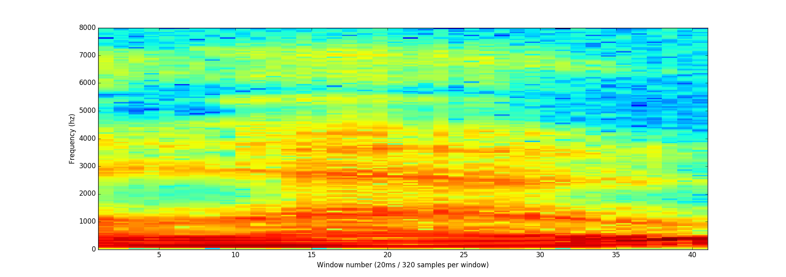
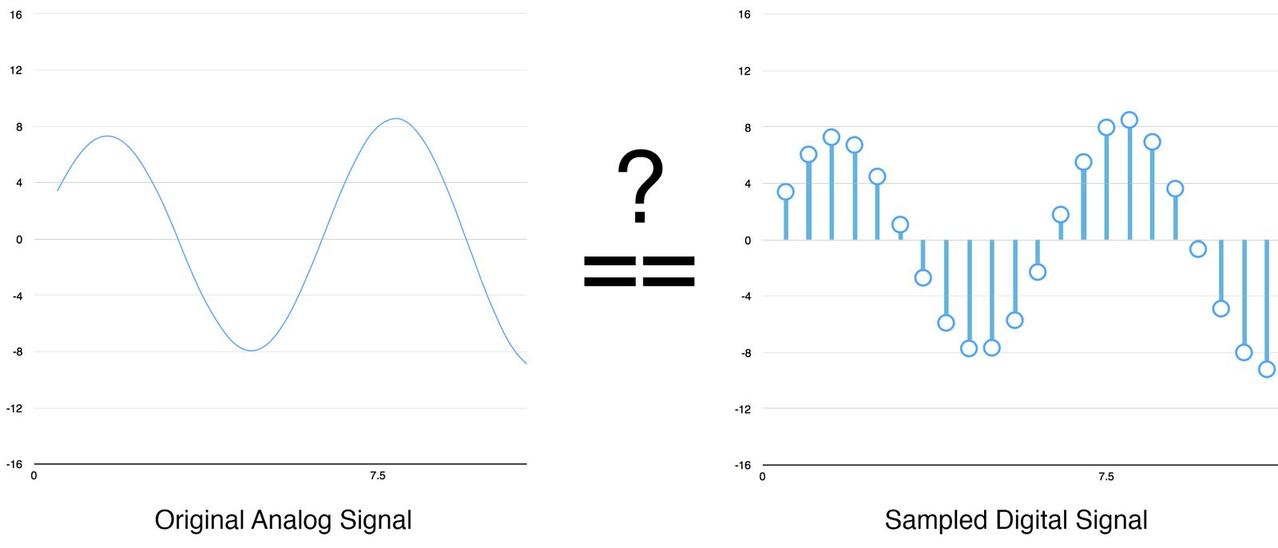
Speech Recognition
Examples of Feature Engineering
Check Blog: https://medium.com/@ageitgey/machine-learning-is-fun-part-6-how-to-do-speech-recognition-with-deep-learning-28293c162f7a

Slide 49
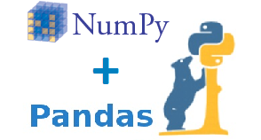
Programming Tips: Numpy/Pandas
Numpy: A fundamental package for scientific computing with Python. It has following functions
Operations of N-dimensional array object (matrix, tensor)
Useful linear algebra, mathematical transform, and random number capabilities
Pandas: Provide high-performance, easy-to-use data structures and data analysis toolkit for the Python language
Installation Guide: → Install numpy → Install pandas
Tutorials: → numpy quickstart → pandas tutorial
Cheatsheet: → numpy cheatsheet → pandas cheatsheet

Slide 50
Programming Tips: Numpy/Pandas
What do you need from numpy and pandas in homework?
Numpy:
How to create/initialize a numpy array/matrix object
Dimensions of numpy array
Basic operations of numpy array (add, subtract, product, etc)
Indexing, slicing and stacking different arrays
Broadcasting rule
Pandas:
How to load data from file
How data is stored in DataFrame?
How to read and write data by index in DataFrame?
Iterating over a pandas DataFrame

Slide 51
Thank you!
Enjoy “mining” and good luck!

