Slide 1
CS145 Discussion
Week 4
Junheng, Shengming, Yunsheng
10/26/2018

Slide 2
Roadmap
Announcement
Homework 1
Note on Logistic Regression → Exercise 1
Neural Networks
Overview
Forward propagation → Exercise 2, 3
Backpropagation → Exercise 4, 5
Pros and Cons
Homework 2
Note on numerical computation
Note on python plotting
Notes on Numpy vs Panda

Slide 3
Announcement
Homework 2 due next Tuesday (10/30/2018 11:59 pm)
Please double check your submission
Make sure you can unzip
Report is important
Unwise to leave any problem blank
PDF file is much better than TXT files
ZIP file makes life much easier (no 7z file or rar file please)
Report all necessary values on your report rather than a pointer to your code
Project midterm report due 11/12
Your team is required to submit to Kaggle at least once
Detailed requirement will be posted soon

Slide 4
Homework 1: Note

Slide 5
HW 1, Logistic Regression:
Why the difference?
python logisticRegression.py 0 0
Learning Algorithm Type: 0
Is normalization used: 0
Beta Starts: [0.21786753 0.55430027 0.93930025 0.40048303 0.56706405]
average logL for iteration 0: 3.0665982168306196
average logL for iteration 1000: 0.1346015208194089
average logL for iteration 2000: 0.09611998275763771
average logL for iteration 3000: 0.08019343404773255
...
average logL for iteration 23000: 0.034675192368321416
average logL for iteration 24000: 0.034196784110673
Beta: [ 2.38942064 -2.26606374 -1.32837263 -1.55395439 -0.16195076]
Training avgLogL: 0.033751622818600426
Test accuracy: 0.9890510948905109
python logisticRegression.py 1 0
Learning Algorithm Type: 1
Is normalization used: 0
Beta Starts: [0. 0. 0. 0. 0.]
average logL for iteration 0: 0.1950693606893002
average logL for iteration 1000: 0.018429477101347867
average logL for iteration 2000: 0.018429477101347843
average logL for iteration 3000: 0.018429477101347843
...
average logL for iteration 23000: 0.018429477101347867
average logL for iteration 24000: 0.018429477101347843
Beta: [ 7.31317701 -7.70705368 -4.15787617 -5.21346398 -0.58583733]
Training avgLogL: 0.018429477101347843
Test accuracy: 0.9890510948905109

Slide 6
HW 1, Logistic Regression:
Why the difference?
Fact: The loss function of logistic regression is convex.
(Check http://mathgotchas.blogspot.com/2011/10/why-is-error-function-minimized-in.html)

Slide 7
Exercise 1: Is there a closed-form solution to Logistic Regression?

Slide 8
Now, back to HW 1, Logistic Regression:
Why the difference?

Slide 9
Neural Networks

Slide 10
Neural Networks: Nonlinear Decision Boundary
https://towardsdatascience.com/lets-code-a-neural-network-in-plain-numpy-ae7e74410795

Slide 11
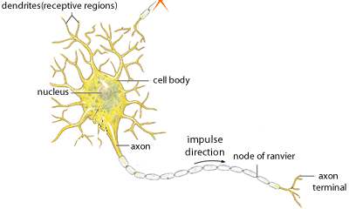
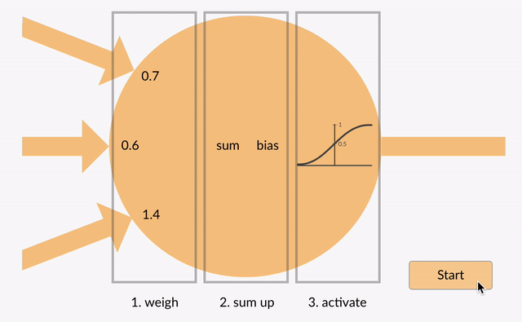
Neural Networks: Neuron/Perceptron
https://medium.com/typeme/lets-code-a-neural-network-from-scratch-part-1-24f0a30d7d62
https://becominghuman.ai/what-is-an-artificial-neuron-8b2e421ce42e

Slide 12
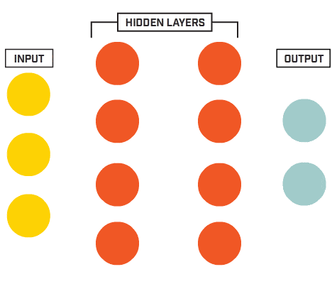
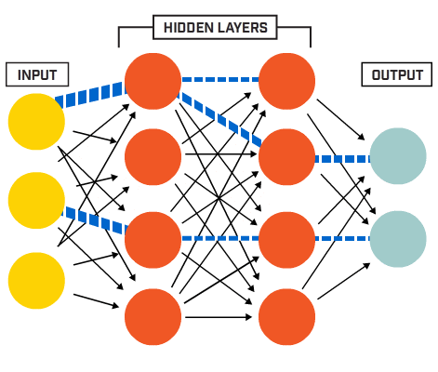
Neural Networks: A Simple Architecture
https://www.ptgrey.com/deep-learning

Slide 13
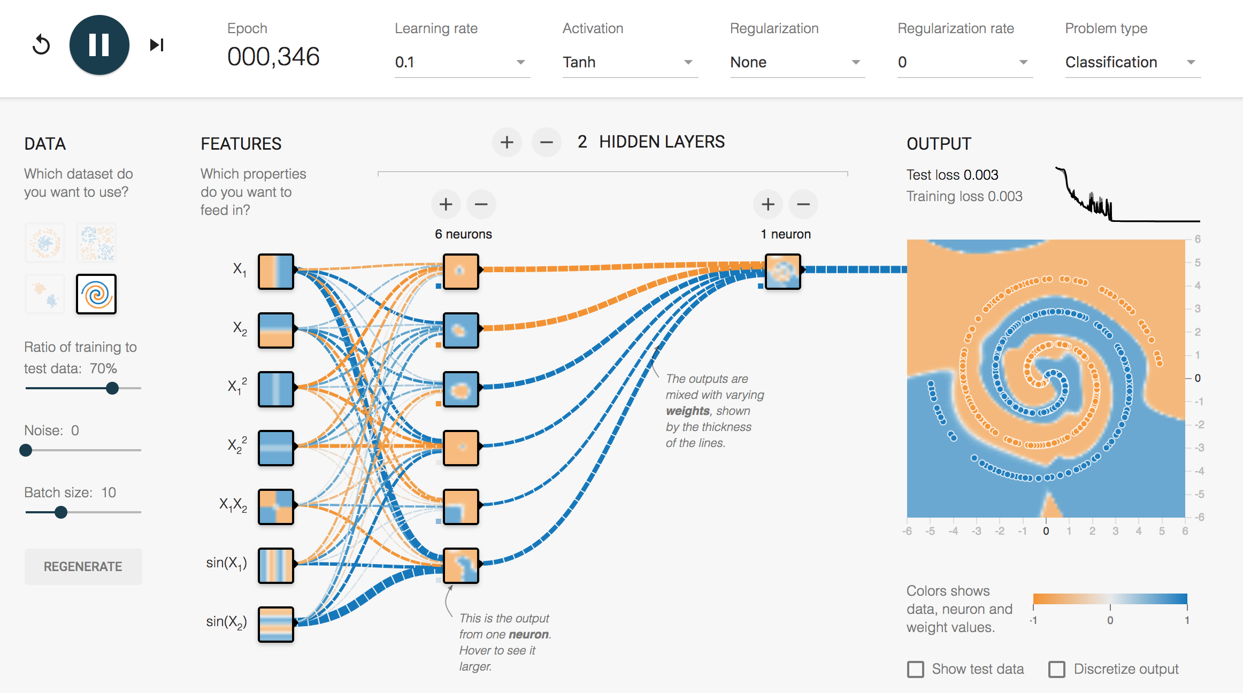
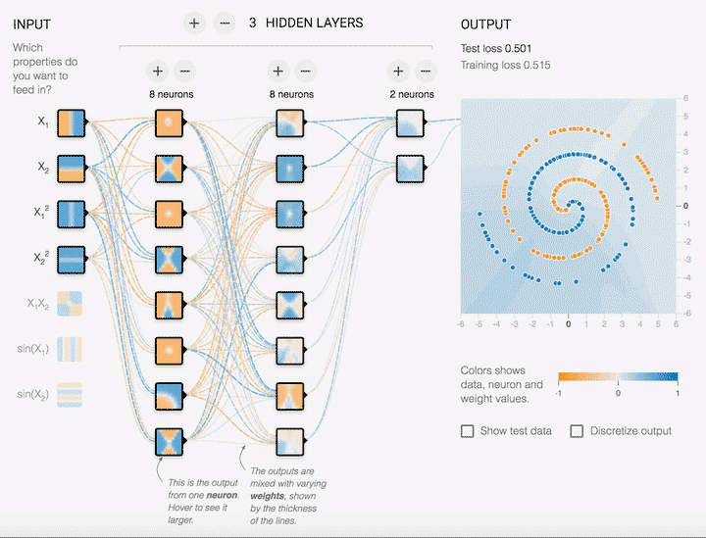
Neural Networks: Flexibility!
Let’s play with it: https://playground.tensorflow.org/

Slide 14
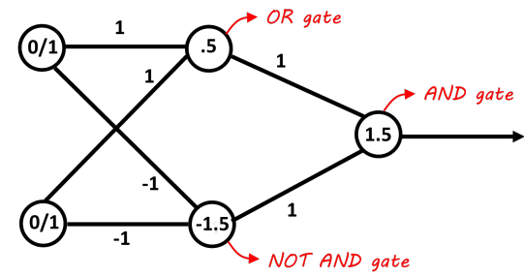
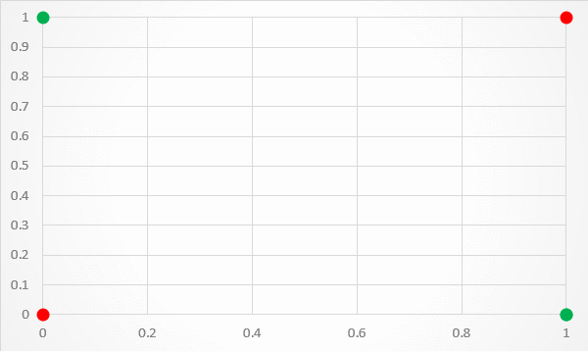
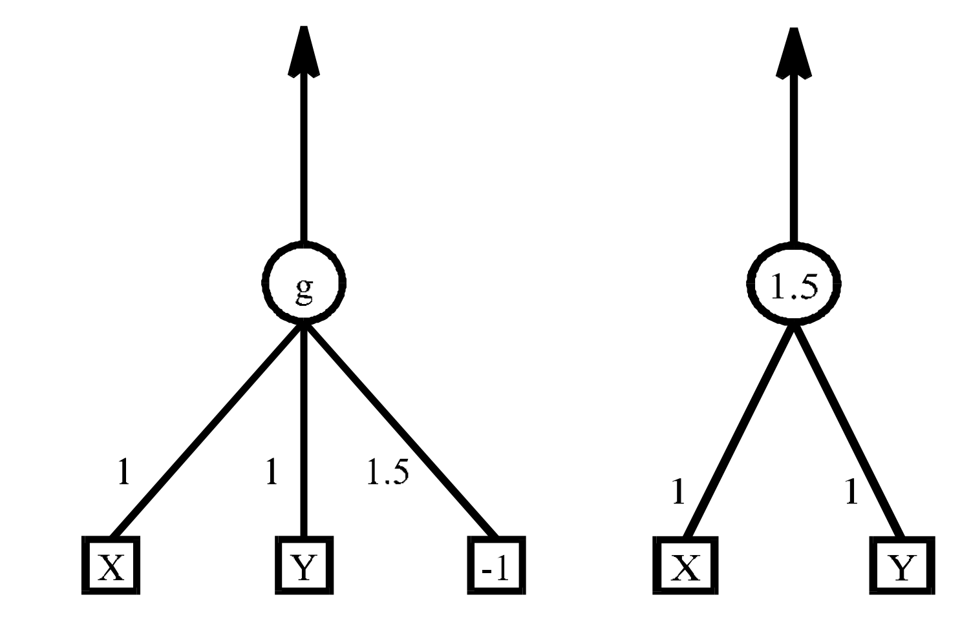
Exercise 2: XOR
Which NN architecture corresponds to which function?
threshold
(a)
(b)
Heaviside step function
(c)
https://datascience.stackexchange.com/questions/11589/creating-neural-net-for-xor-function
http://yen.cs.stir.ac.uk/~kjt/techreps/pdf/TR148.pdf
https://medium.com/@jayeshbahire/the-xor-problem-in-neural-networks-50006411840b

Slide 15
Exercise 2: XOR
(a)
(b)
(c)
https://datascience.stackexchange.com/questions/11589/creating-neural-net-for-xor-function
http://yen.cs.stir.ac.uk/~kjt/techreps/pdf/TR148.pdf
https://medium.com/@jayeshbahire/the-xor-problem-in-neural-networks-50006411840b

Slide 16
Exercise 2: XOR
Detailed Explanation
We can also use the Heaviside step function instead of sigmoid
x₁
x₂
x₁
x₂
https://www.youtube.com/watch?v=kNPGXgzxoHw

Slide 17
Exercise 3
Let’s revisit the quiz we did in Monday’s lecture!
Can linear SVMs be considered as a special case of neural networks?
How about nonlinear SVMs?
How about decision trees?

Slide 18
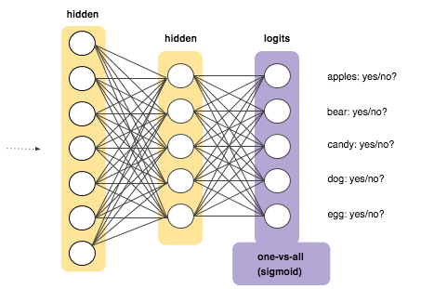
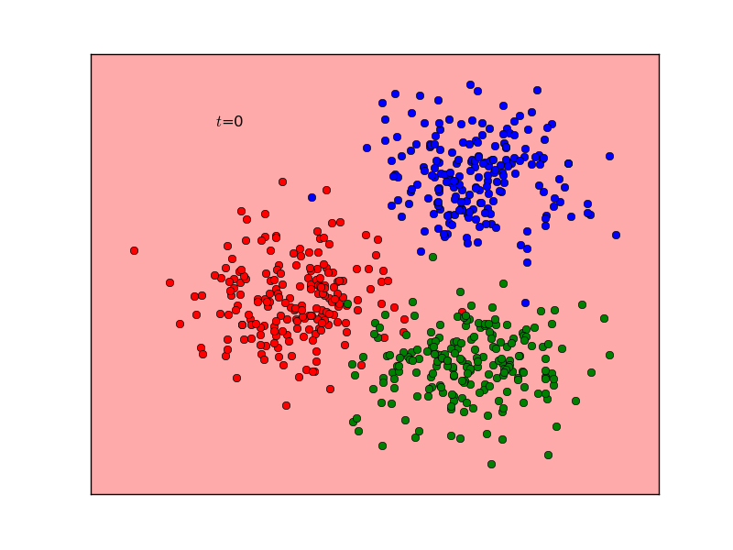
Multiclass Classification
?
5 separate binary classifiers
Key: sharing the same hidden layers with different weights at the end
Question: Pros and cons?
https://developers.google.com/machine-learning/crash-course/multi-class-neural-networks/one-vs-all
http://www.briandolhansky.com/blog/2013/9/23/artificial-neural-nets-linear-multiclass-part-3

Slide 19
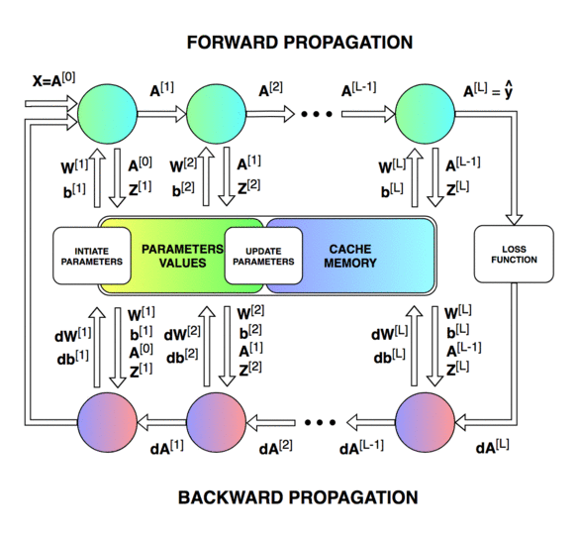
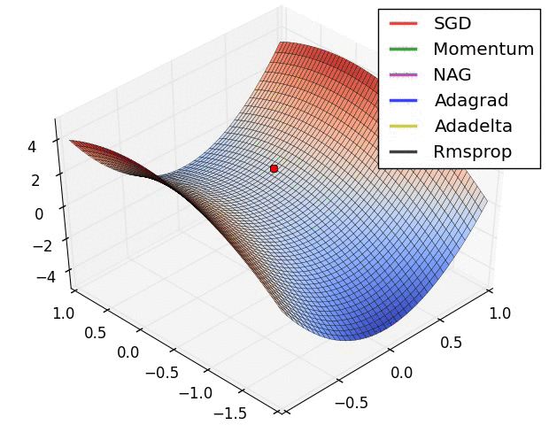
Neural Networks:
Backpropagation
https://medium.com/datathings/neural-networks-and-backpropagation-explained-in-a-simple-way-f540a3611f5e

Slide 20
How many iterations are needed to converge?
Depends on:
Architecture/Meta-parameters of the network, e.g. # layers, activation
Quality of training data (input-output correlation, normalization, noise cleansing, class distribution/imbalance)
Random initialization of the parameters/weights
Optimization algorithm, e.g. SGD, Adam, etc.
Learning rate
Batch size
(In practice) Implementation quality (Bug-free? Optimized?)
...
https://medium.com/datathings/neural-networks-and-backpropagation-explained-in-a-simple-way-f540a3611f5e
https://www.quora.com/Machine-Learning-What-are-some-tips-and-tricks-for-training-deep-neural-networks

Slide 21
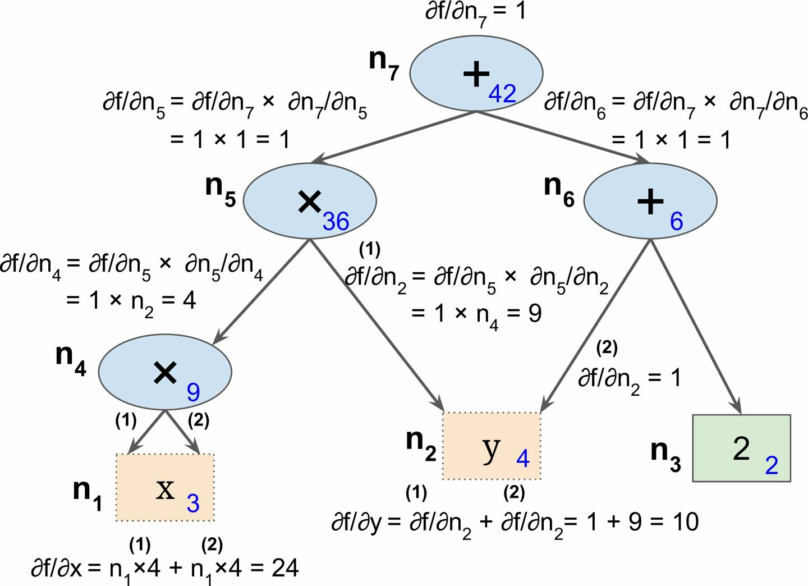
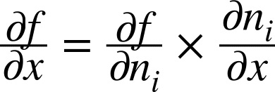
Neural Networks:
Backpropagation
A simple example to understand the intuition
f(x,y) = x²y + y + 2
Forward pass:
x = 3, y = 4 → f(3, 4)=42
Backward pass:
Chain rule:
See the diagram
Fun fact: This is called reverse-mode autodiff and how Tensorflow works
Géron, Aurélien. Hands-on machine learning with Scikit-Learn and TensorFlow: concepts, tools, and techniques to build intelligent systems. " O'Reilly Media, Inc.", 2017.

Slide 22
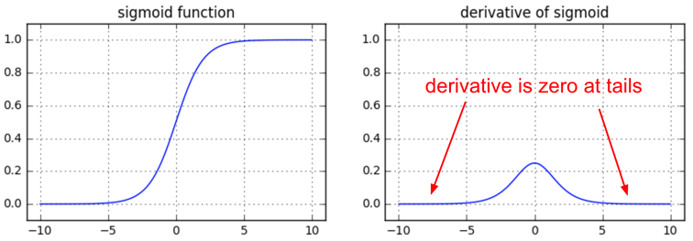
Why understanding backpropagation?
“Why do we have to write the backward pass when frameworks in the real world, such as TensorFlow, compute them for you automatically?”
Vanishing gradients on sigmoids
https://medium.com/@karpathy/yes-you-should-understand-backprop-e2f06eab496b

Slide 23
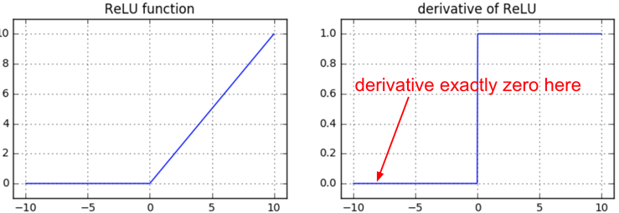
Why understanding backpropagation?
“Why do we have to write the backward pass when frameworks in the real world, such as TensorFlow, compute them for you automatically?”
Dying ReLUs
https://medium.com/@karpathy/yes-you-should-understand-backprop-e2f06eab496b

Slide 24
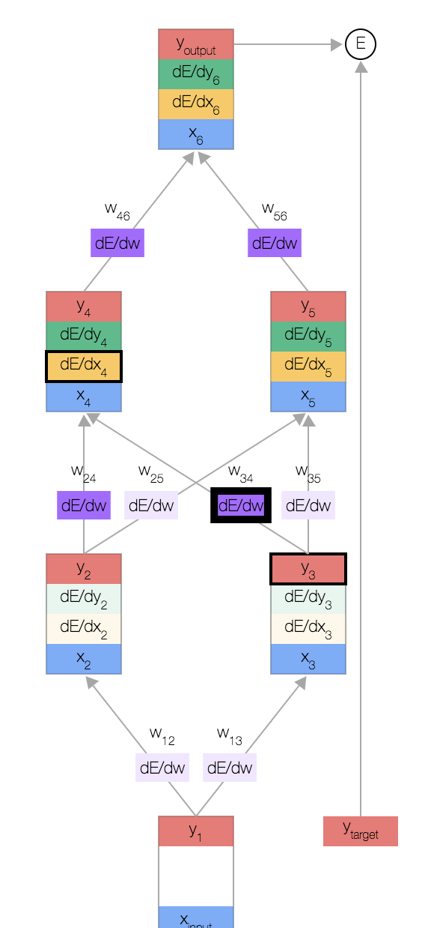
Neural Networks:
Backpropagation
Backpropagation (Interactive): https://google-developers.appspot.com/machine-learning/crash-course/backprop-scroll/
Backpropagation (CS 231n at Stanford): https://cs231n.github.io/optimization-2/ and https://www.youtube.com/watch?v=i94OvYb6noo
(Optional) Matrix-Level Operation: https://medium.com/@14prakash/back-propagation-is-very-simple-who-made-it-complicated-97b794c97e5c

Slide 25
Exercise 4
Suppose you have a fully-connected multilayer neural network with 1 input, 2 hidden and 1 output layers. If your dataset has p features, the two hidden layers have 3 and 4 neurons respectively, and the output layer has k outputs, calculate the number of parameters in the neural network in terms of p and k. Assume that the bias terms have not been considered in the specified neurons and need to be added to the parameter count.

Slide 26
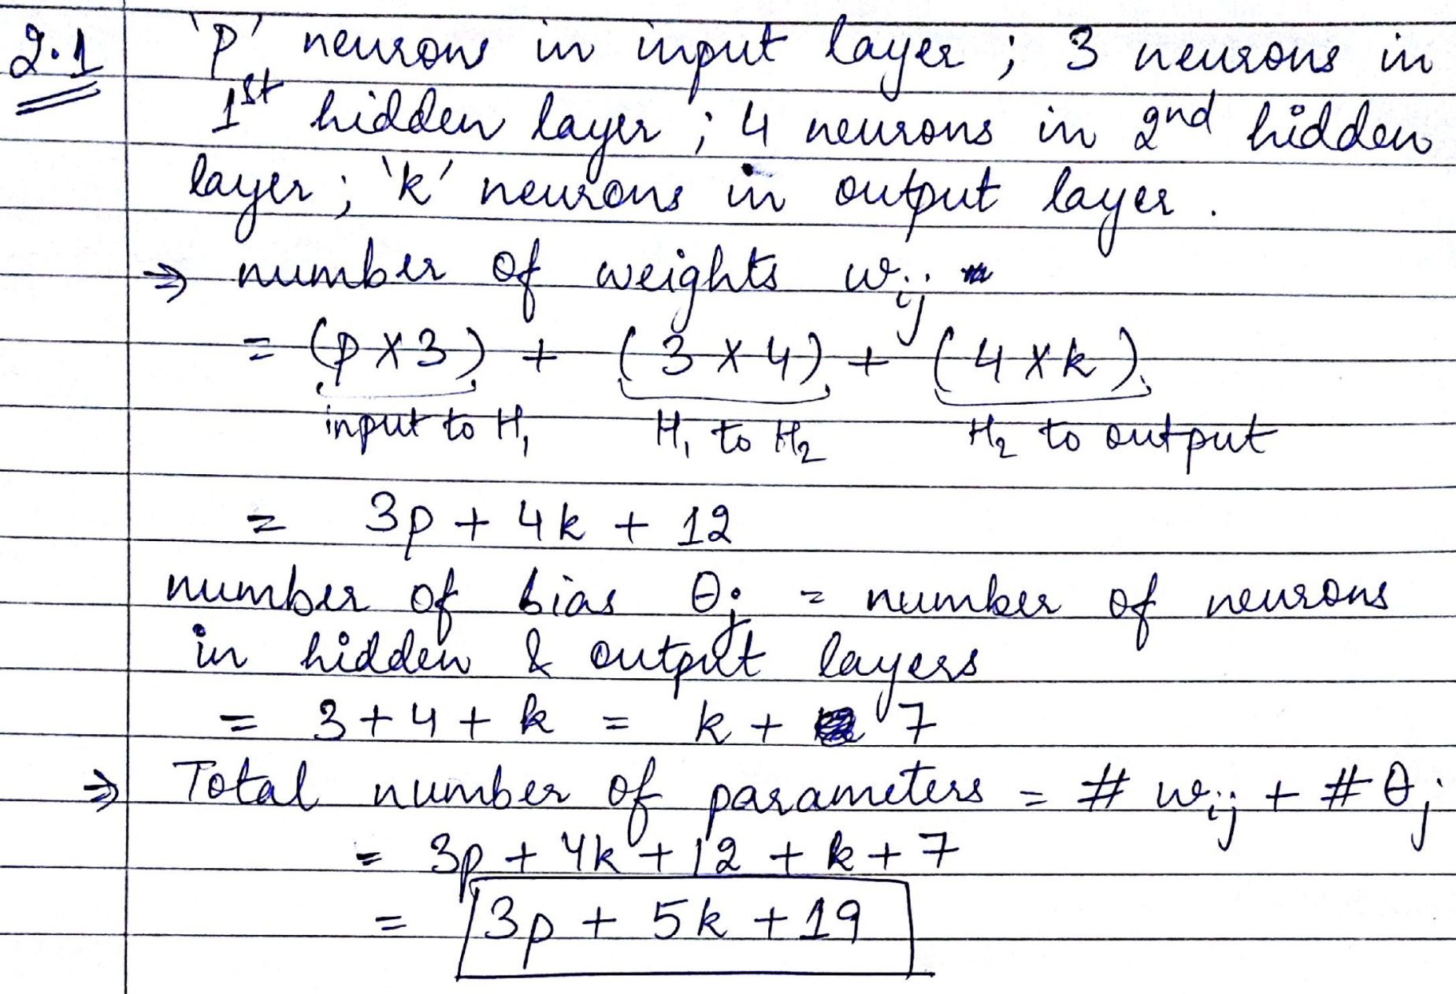

Slide 27
Exercise 5
Write down the major steps involved in backpropagation algorithm.

Slide 28
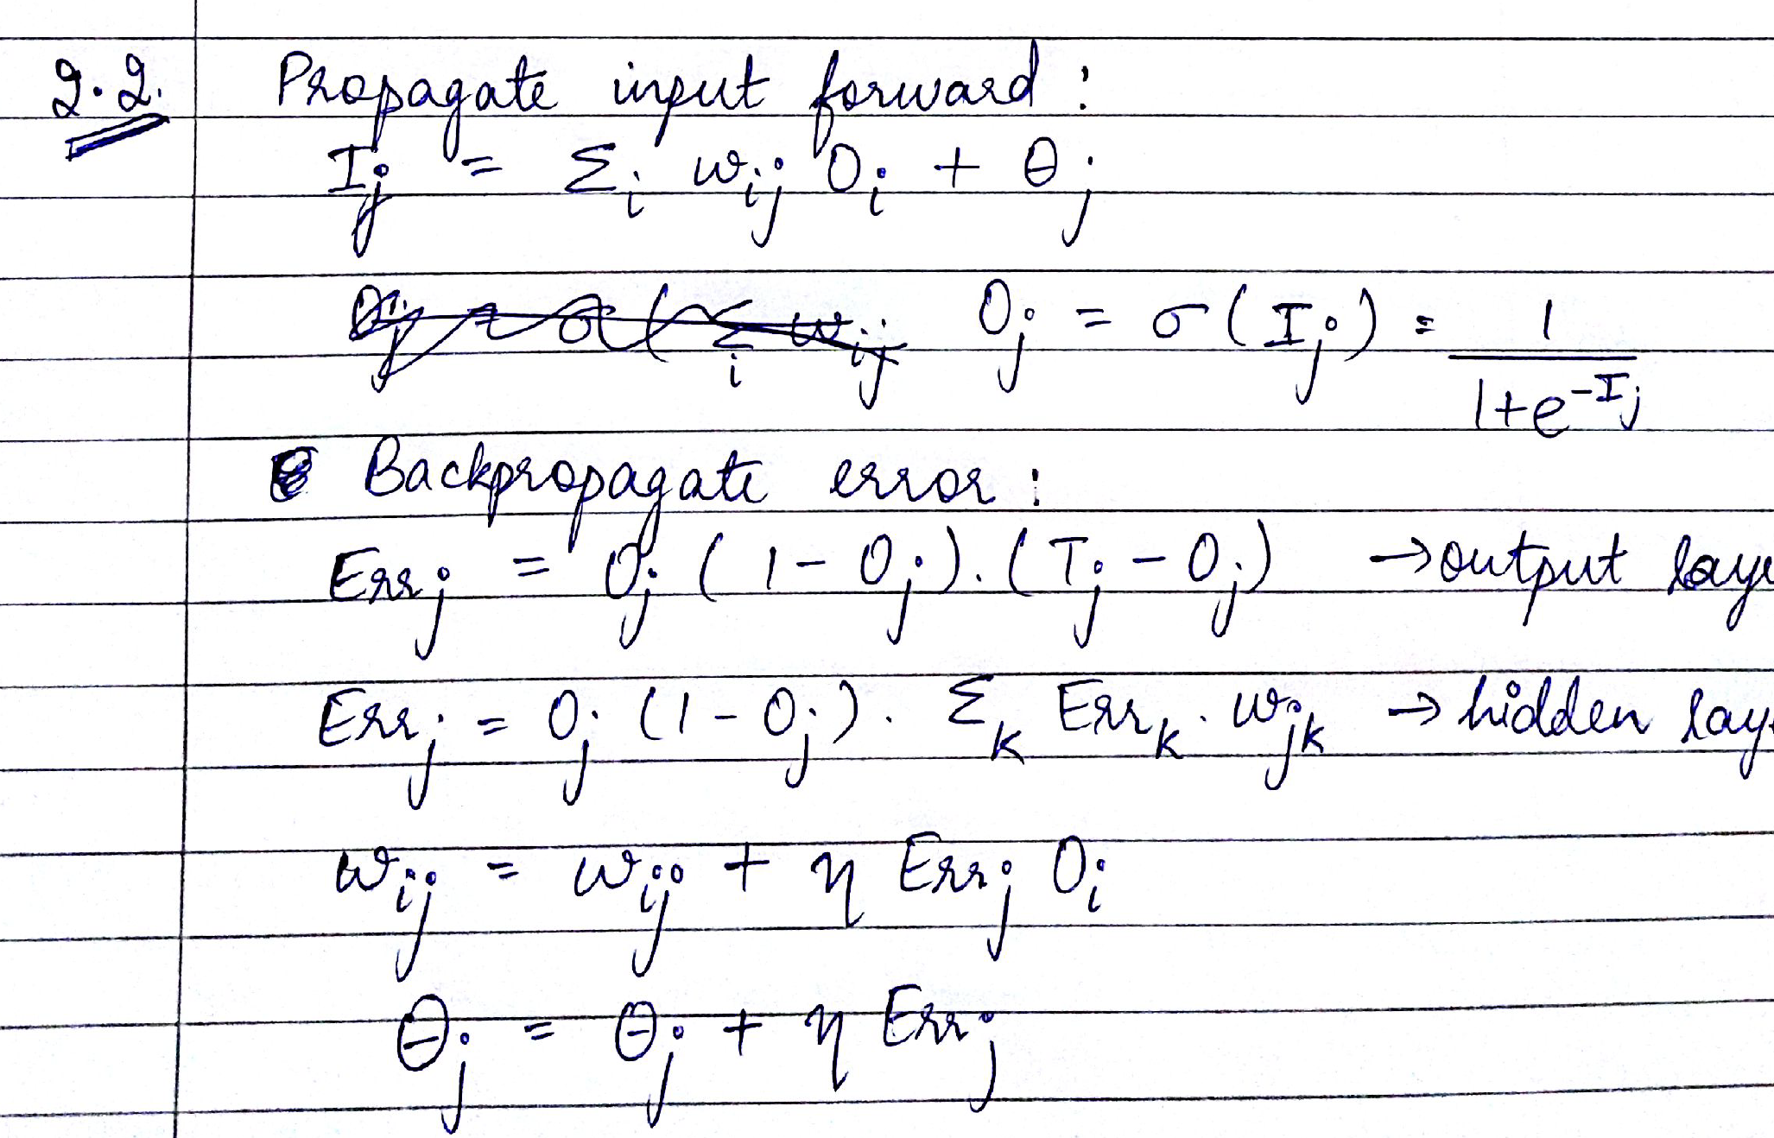

Slide 29
Exercise 5
Given the following multilayer neural network, a training data point x=(x₁=0,x₂=1), and the target value T=1, please calculate weights and bias after 1 iteration of backpropagation algorithm (show your calculations and fill out the empty tables given below). The learning rate =0.8. The initial weights and bias are in the following table.
w₁₃ | w₁₄ | w₂₃ | w₂₄ | w₃₅ | w₄₅ | 3 | 4 | 5
-0.3 | 0.2 | 0.4 | -0.1 | -0.2 | -0.3 | 0.2 | -0.4 | 0.1

Slide 30
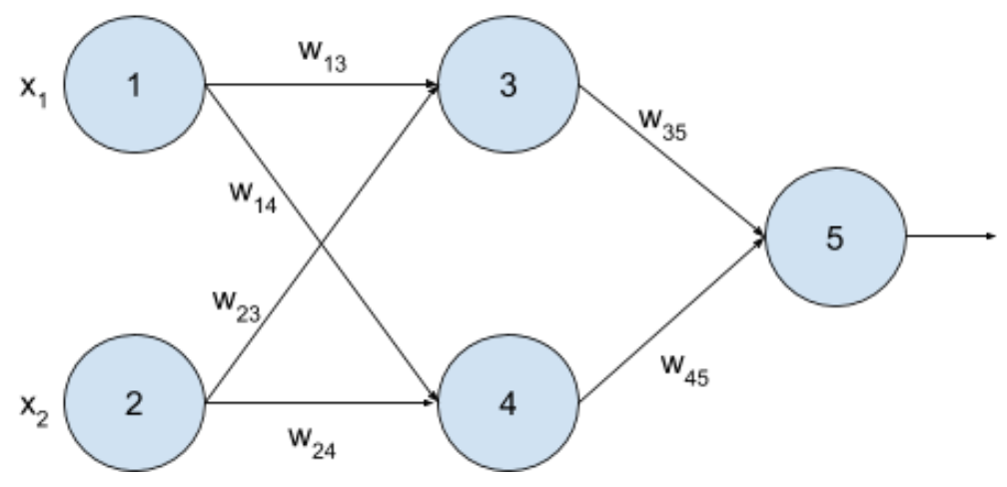
Exercise 5

Slide 31
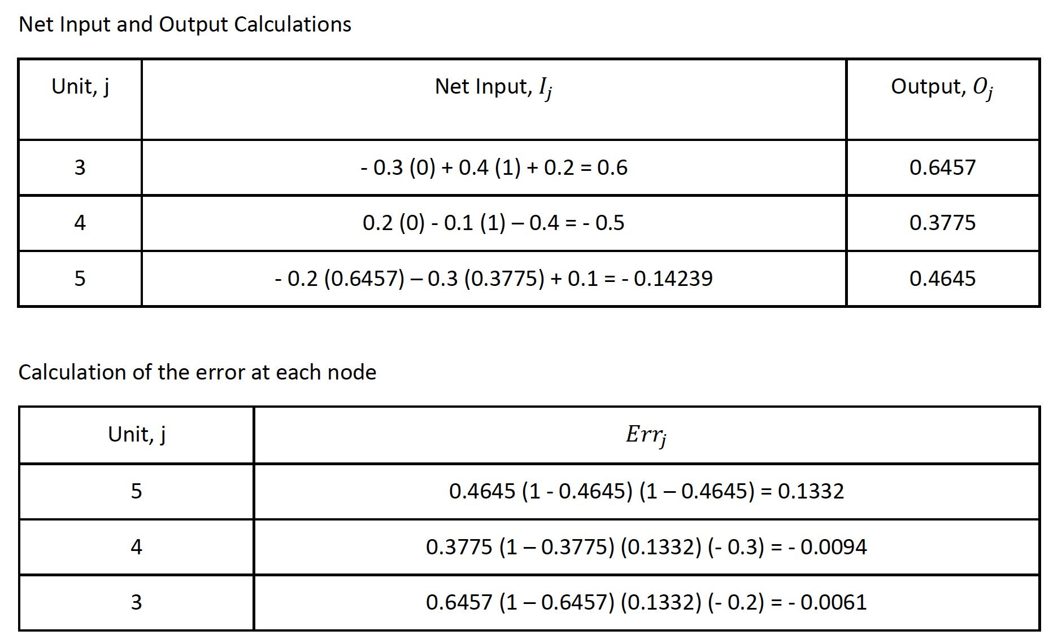
Pay attention to whether it is err or derivative.

Slide 32
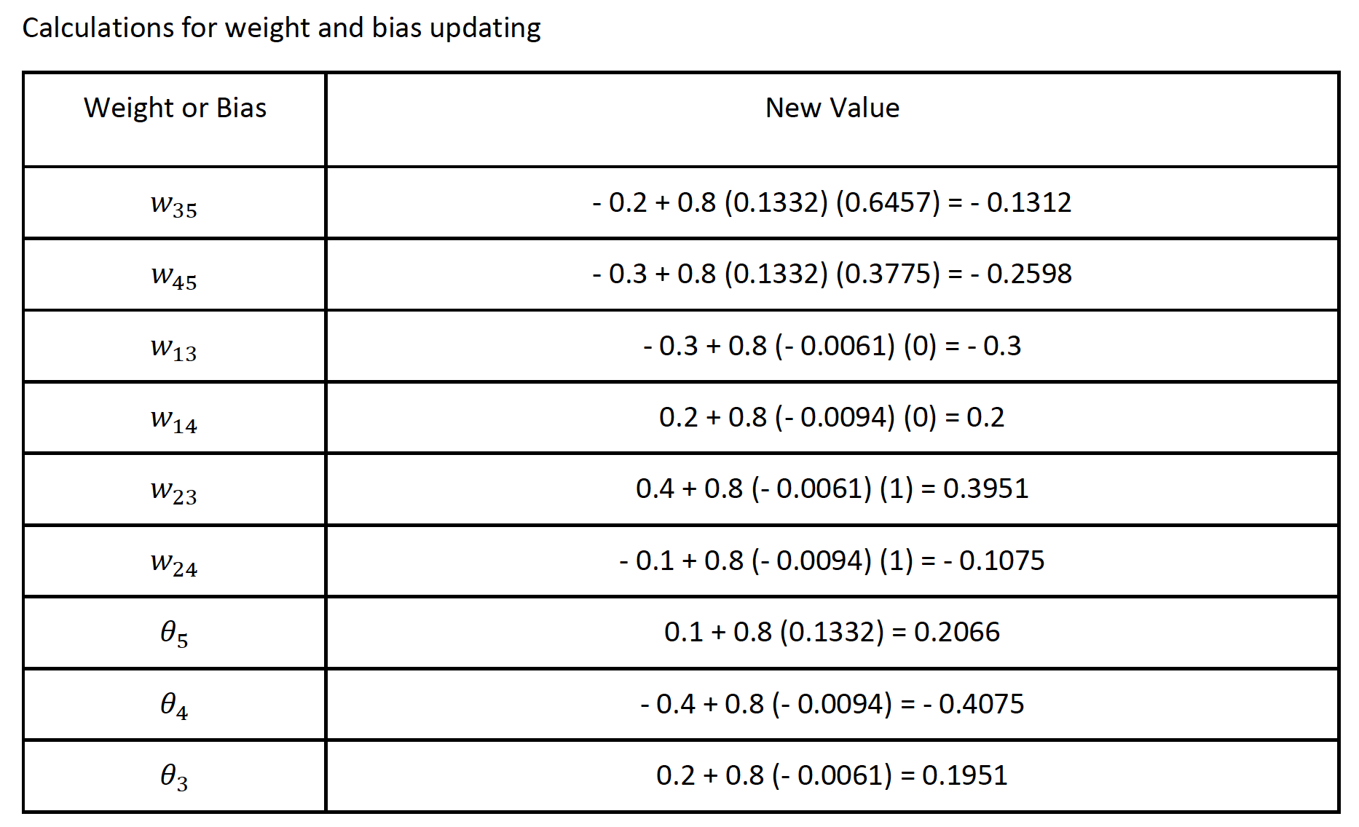
Pay attention to the sign here! If err, +; If derivative, - (~SGD).

Slide 33
Neural Networks: Pros and Cons

Slide 34
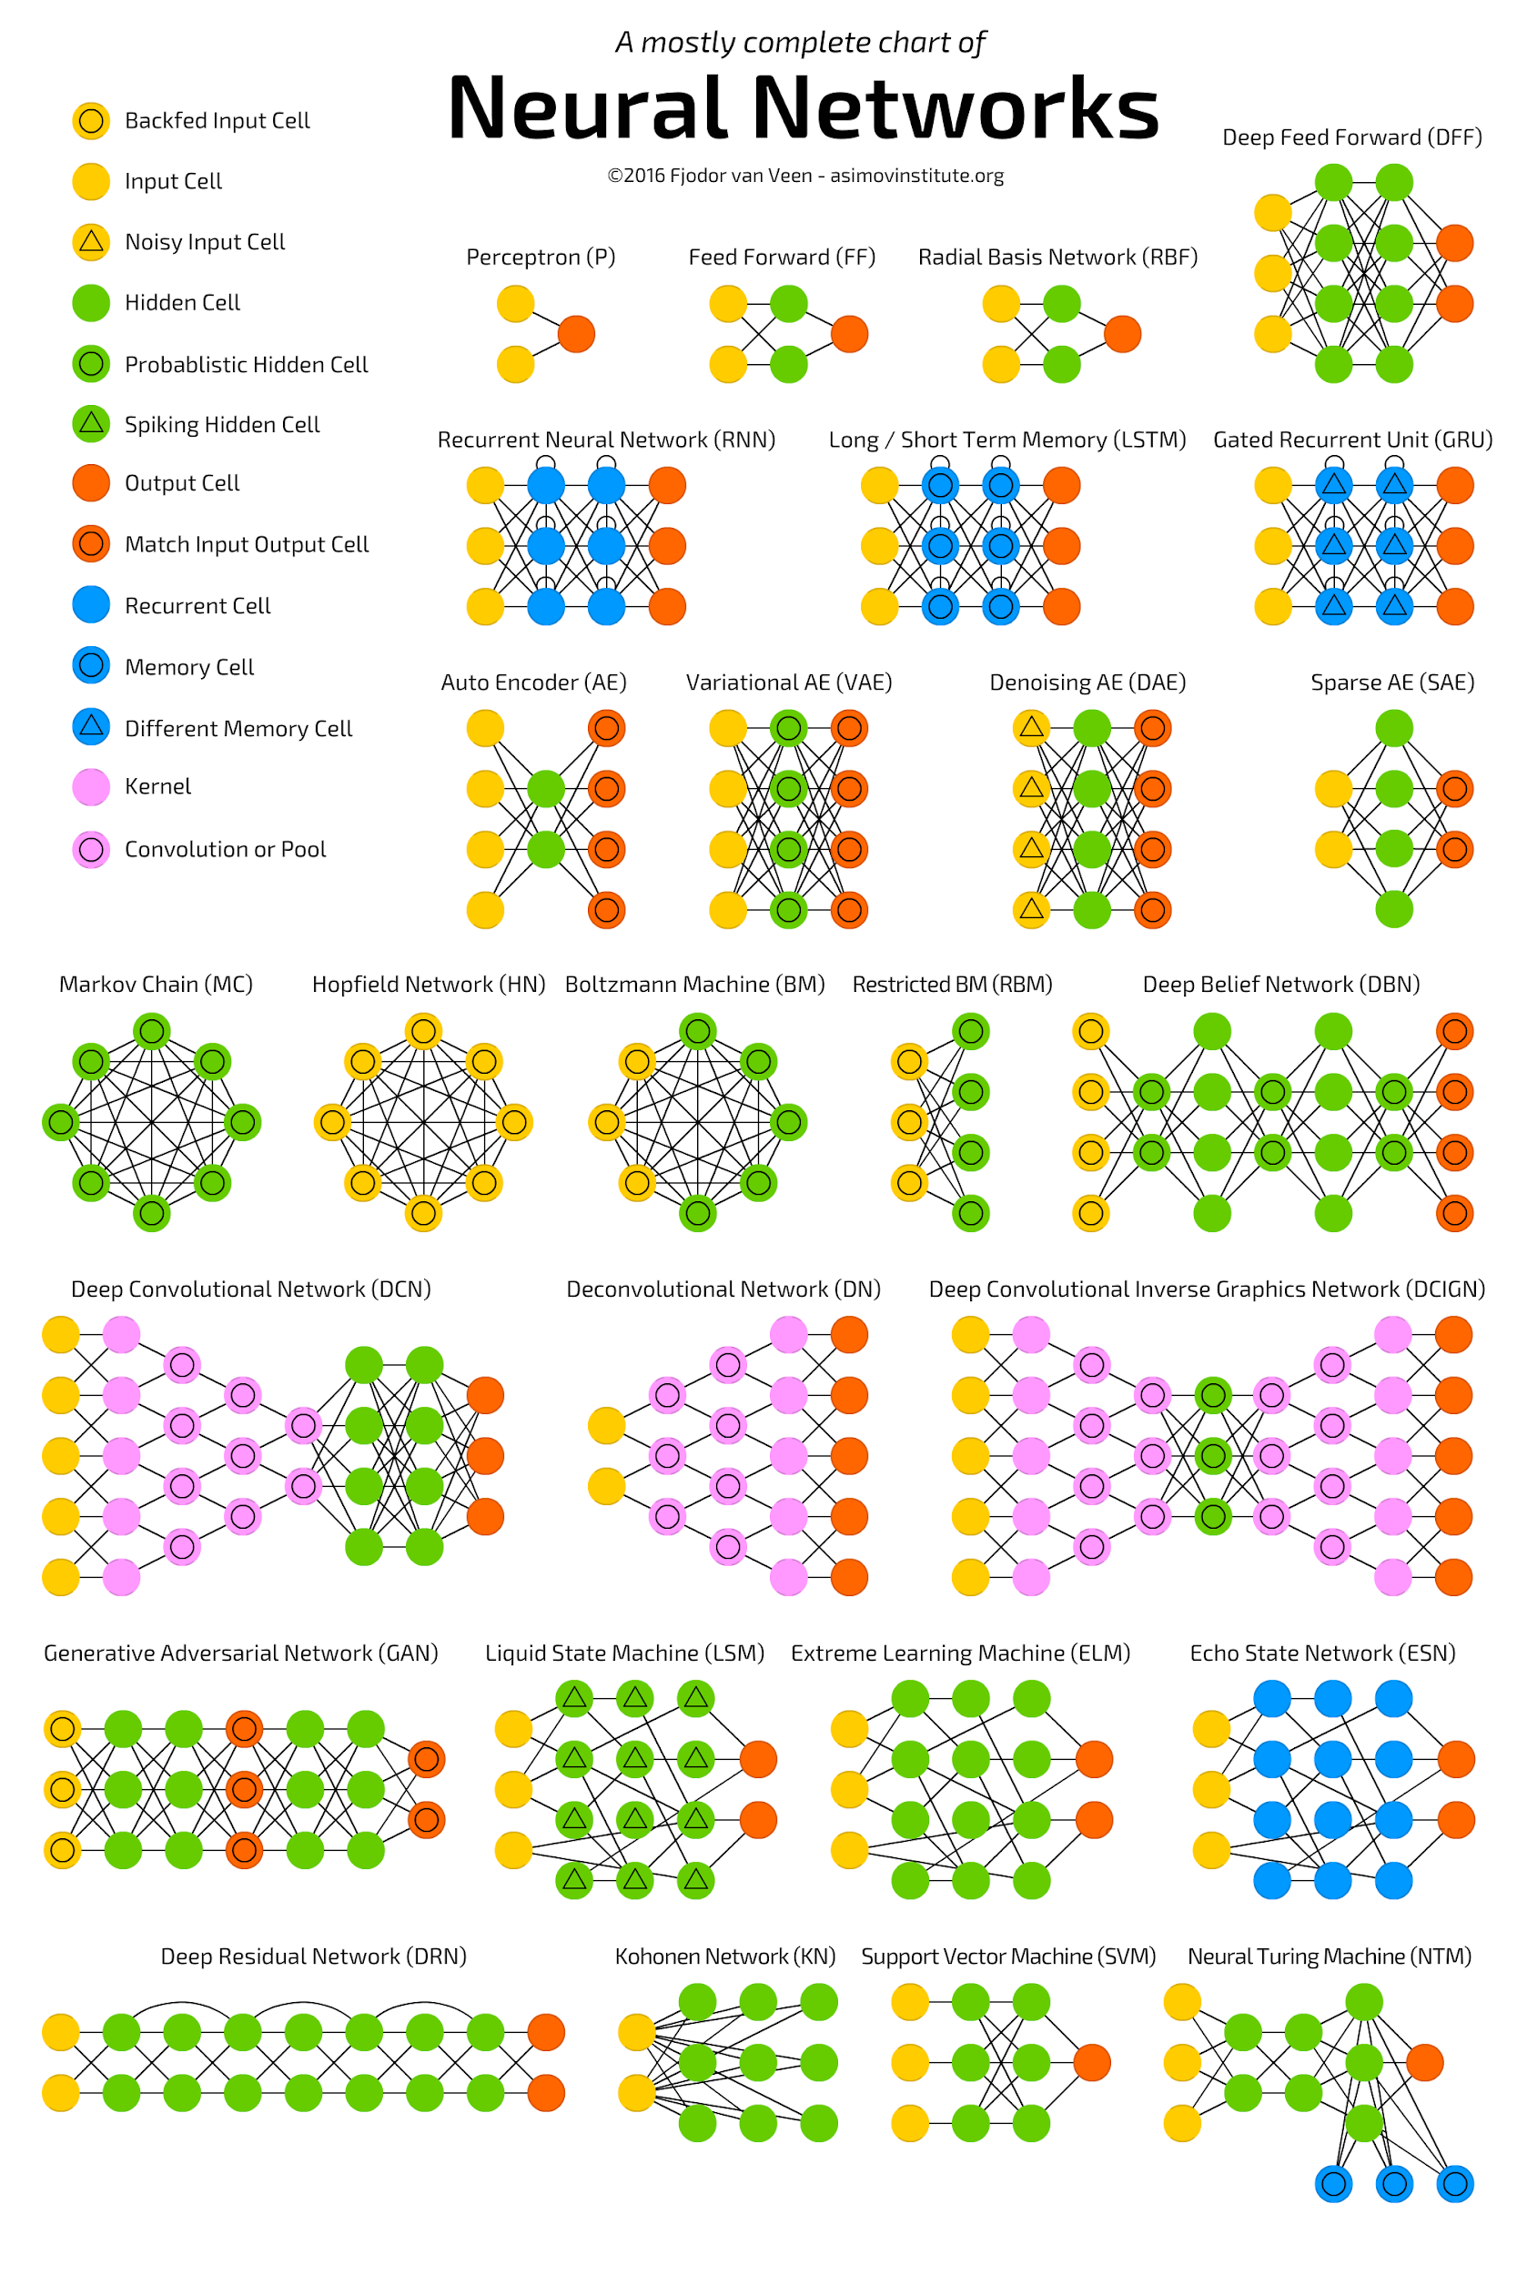
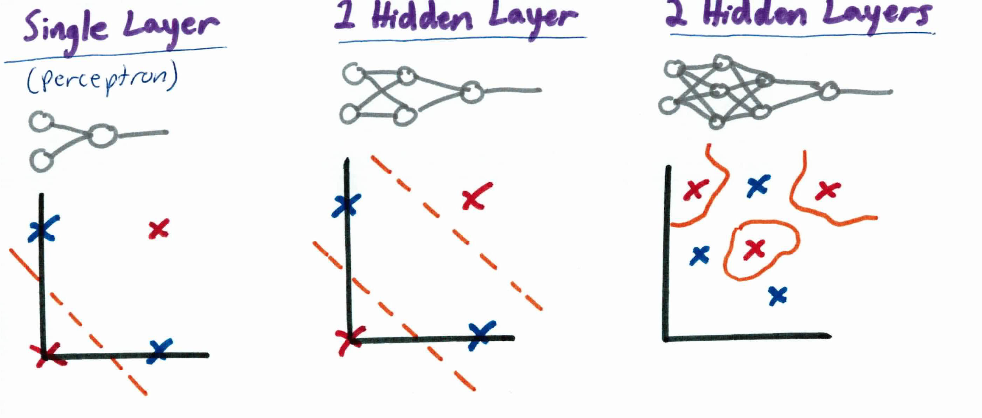
Neural Networks:
Pros and Cons
Flexibility
https://www.packtpub.com/mapt/book/big_data_and_business_intelligence/9781788397872/1/ch01lvl1sec27/pros-and-cons-of-neural-networks
http://kseow.com/nn/
https://towardsdatascience.com/hype-disadvantages-of-neural-networks-6af04904ba5b

Slide 35
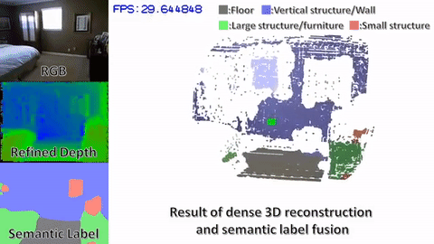
Neural Networks: Pros and Cons
Efficiency (In many cases, prediction/inference/testing is fast)
https://www.packtpub.com/mapt/book/big_data_and_business_intelligence/9781788397872/1/ch01lvl1sec27/pros-and-cons-of-neural-networks
http://www.luigifreda.com/2017/04/08/cnn-slam-real-time-dense-monocular-slam-learned-depth-prediction/
http://www.missqt.com/google-translate-app-now-supports-instant-voice-and-visual-translations/

Slide 36
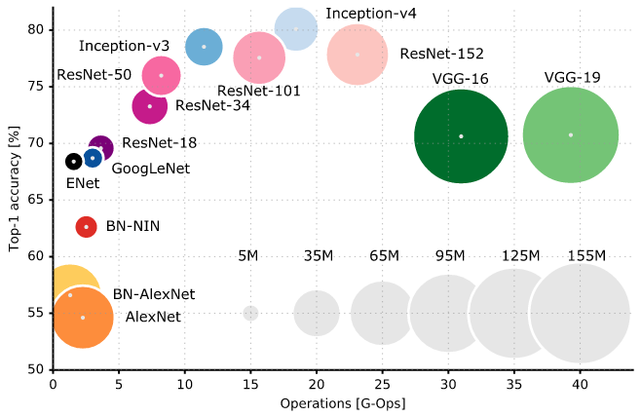
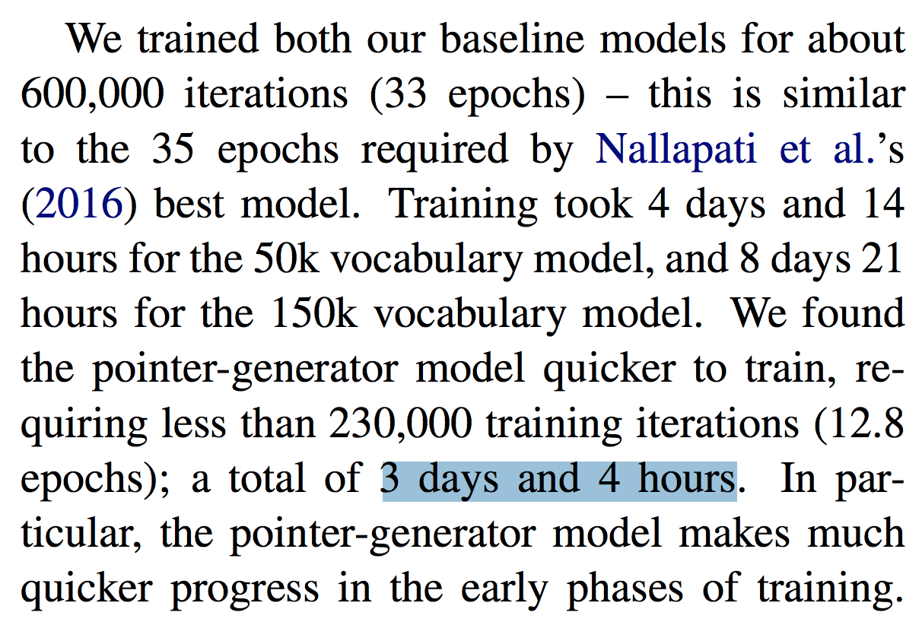
Neural Networks: Pros and Cons
Efficiency (Big model → slow training, huge energy consumption (e.g. for cell phone))
https://www.kdnuggets.com/2017/08/first-steps-learning-deep-learning-image-classification-keras.html/2
See, Abigail, Peter J. Liu, and Christopher D. Manning. "Get to the point: Summarization with pointer-generator networks." arXiv preprint arXiv:1704.04368 (2017).
https://www.lifewire.com/my-iphone-wont-charge-what-do-i-do-2000147

Slide 37
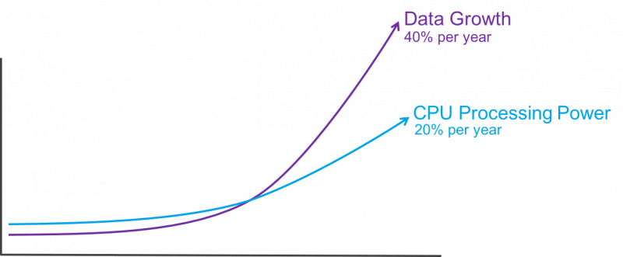
Neural Networks: Pros and Cons
Data (Both a pro and a con)
https://towardsdatascience.com/hype-disadvantages-of-neural-networks-6af04904ba5b

Slide 38
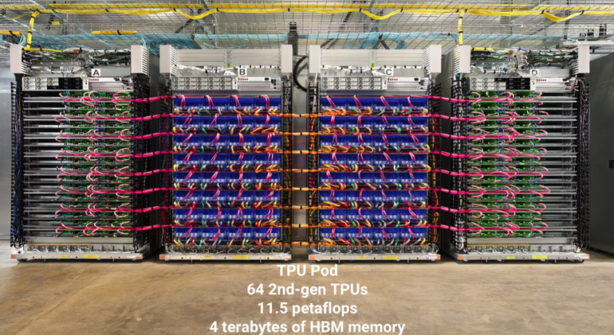
Neural Networks: Pros and Cons
Computational Power (Both a pro and a con)
https://www.anandtech.com/show/10864/discrete-desktop-gpu-market-trends-q3-2016
https://www.zdnet.com/article/gpu-killer-google-reveals-just-how-powerful-its-tpu2-chip-really-is/

Slide 39
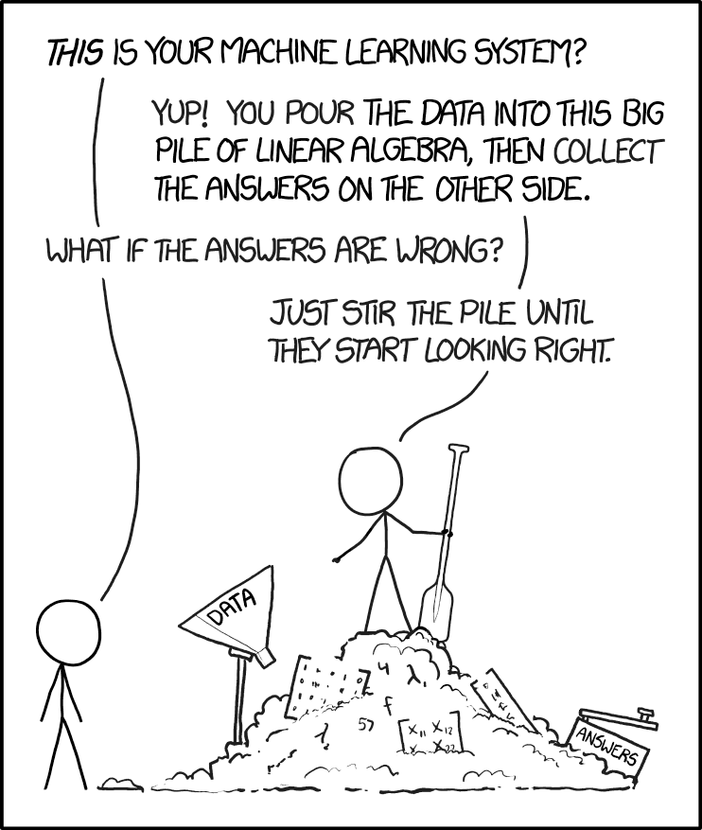
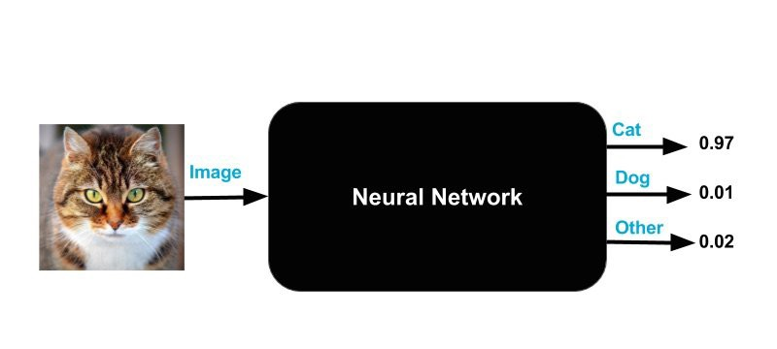
Neural Networks: Pros and Cons
Black Box
Interpretability
https://towardsdatascience.com/hype-disadvantages-of-neural-networks-6af04904ba5b
https://xkcd.com/1838/

Slide 40
Homework 2: Notes

Slide 41
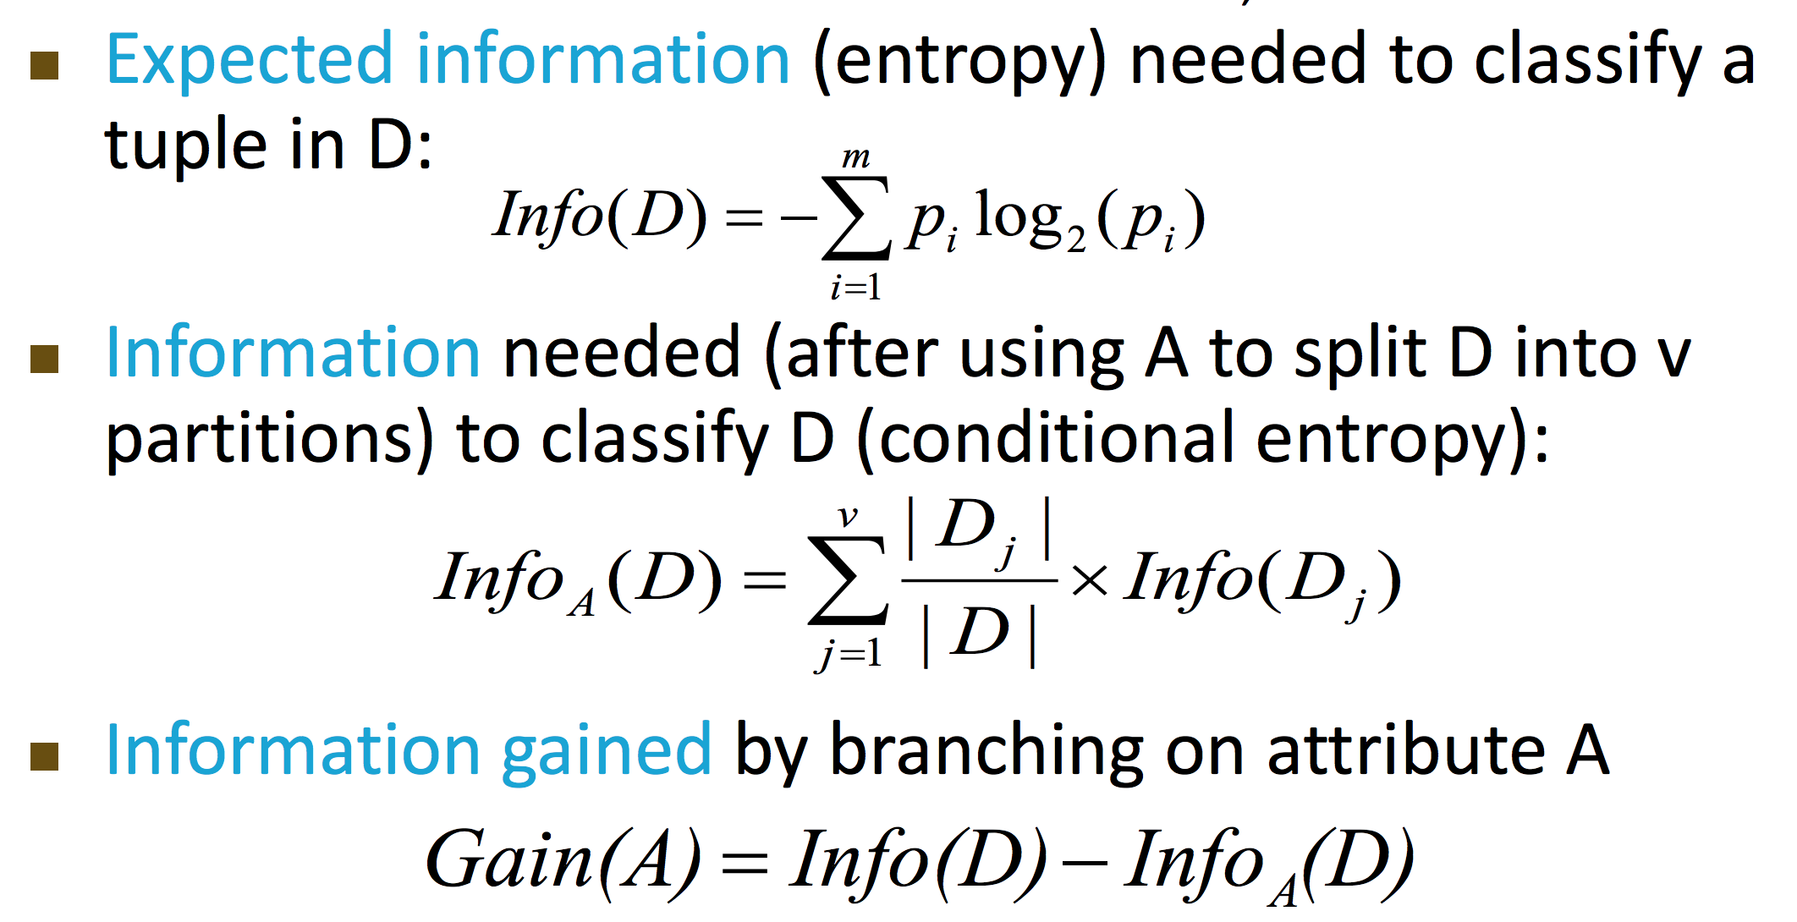
HW 2, Prob 1.2: Numerically Different
Step (1)
Step (2)

Slide 42
HW 2, Prob 1.2: Numerically Different
Step (1)
Step (2)

Slide 43
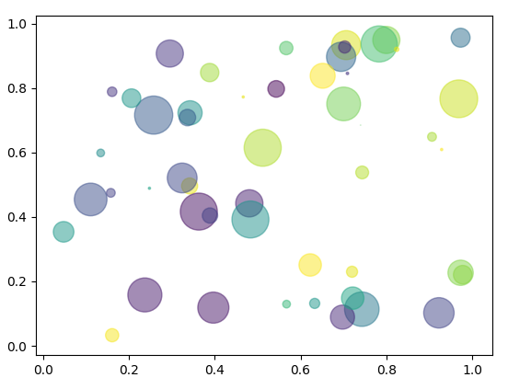
HW 2, Problem 2.1 (f):
How to Plot with Python?
Use Matplotlib
A simple example:
import numpy as np import matplotlib.pyplot as plt # Fixing random state for reproducibility np.random.seed(19680801)
N = 50 x = np.random.rand(N) y = np.random.rand(N) colors = np.random.rand(N) area = (30 * np.random.rand(N))**2 # 0 to 15 point radii plt.scatter(x, y, s=area, c=colors, alpha=0.5) plt.show()
https://matplotlib.org/gallery/shapes_and_collections/scatter.html#sphx-glr-gallery-shapes-and-collections-scatter-py

Slide 44
HW 2: Numpy vs Pandas
import numpy as np
import pandas as pd
np.random.seed(123)
X = pd.DataFrame(np.random.randint(0,2,size=(2, 4)), columns=list('ABCD'))
print(type(X))
print(X)
way_one = np.dot(X, X.T)
way_two = X.dot(X.T)
print(type(way_one))
print(type(way_two))
print(way_one)
print(way_two)
<class 'pandas.core.frame.DataFrame'>
A B C D
0 0 1 0 0
1 0 0 0 1
<class 'numpy.ndarray'>
<class 'pandas.core.frame.DataFrame'>
[[1 0]
[0 1]]
0 1
0 1 0
1 0 1
Which one to choose? Depends on how you use the result in the homework!
In general, it is a good practice to be always aware of the data type of the variables you use!

Slide 45
HW 2: Numpy vs Pandas
import numpy as np
import pandas as pd
np.random.seed(123)
X_np = np.random.randint(0,2,size=(2, 4))
X_df = pd.DataFrame(X_np, columns=list('ABCD'))
print(type(X_np))
print(X_np)
print()
print(type(X_df))
print(X_df)
print()
print(type(X_np[0]))
# print(type(X_df[0])) # won't work
print(type(X_df.iloc[0]))
print(type(X_df.iloc[[0]]))
print(type(X_df.values[0]))
<class 'numpy.ndarray'>
[[0 1 0 0]
[0 0 0 1]]
<class 'pandas.core.frame.DataFrame'>
A B C D
0 0 1 0 0
1 0 0 0 1
<class 'numpy.ndarray'>
<class 'pandas.core.series.Series'>
<class 'pandas.core.frame.DataFrame'>
<class 'numpy.ndarray'>
https://www.shanelynn.ie/select-pandas-dataframe-rows-and-columns-using-iloc-loc-and-ix/

Slide 46
Thank you!
Q & A

