Slide 1
CS145 Discussion
Week 9
Junheng, Shengming, Yunsheng
11/30/2018

Slide 2
Today’s Discussion
Announcement
Roadmap
Closed Patterns and Max-Patterns
Apriori
FP-Growth
Association Rules & Pattern Evaluation
GSP
PrefixSpan
Q & A

Slide 3
Announcement
Homework 5 due today 23:59pm (Nov 30, 2018)
Submit on CCLE
Must include your report and Python code.
Homework 6 is optional
We will drop the lowest HW score, i.e. take the best out of the 5 HW assignments

Slide 4
Closed Patterns and Max-Patterns
Notes:
Answers: 41-79 for both

Slide 5
Closed Patterns and Max-Patterns

Slide 6
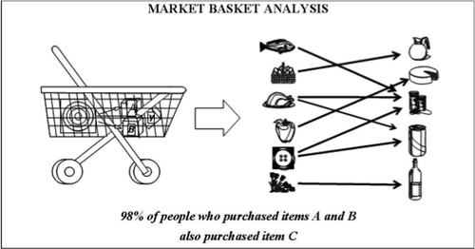
Apriori
https://edumine.wordpress.com/2013/09/11/apriori-algorithm-simplified-with-an-example/

Slide 7
Apriori
https://www.kdnuggets.com/2016/04/association-rules-apriori-algorithm-tutorial.html/2

Slide 8
Apriori: Example 1

Slide 9
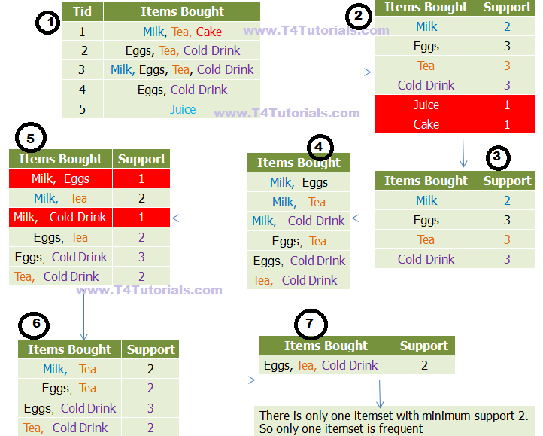
https://t4tutorials.com/apriori-algorithm-in-data-mining-with-examples/
min_support=2

Slide 10
https://t4tutorials.com/apriori-algorithm-in-data-mining-with-examples/
min_support=2

Slide 11
https://t4tutorials.com/apriori-algorithm-in-data-mining-with-examples/
min_support=2

Slide 12
https://t4tutorials.com/apriori-algorithm-in-data-mining-with-examples/
min_support=2

Slide 13
https://t4tutorials.com/apriori-algorithm-in-data-mining-with-examples/
min_support=2

Slide 14
https://t4tutorials.com/apriori-algorithm-in-data-mining-with-examples/
min_support=2

Slide 15
https://t4tutorials.com/apriori-algorithm-in-data-mining-with-examples/
min_support=2

Slide 16
Apriori: Example 2

Slide 17
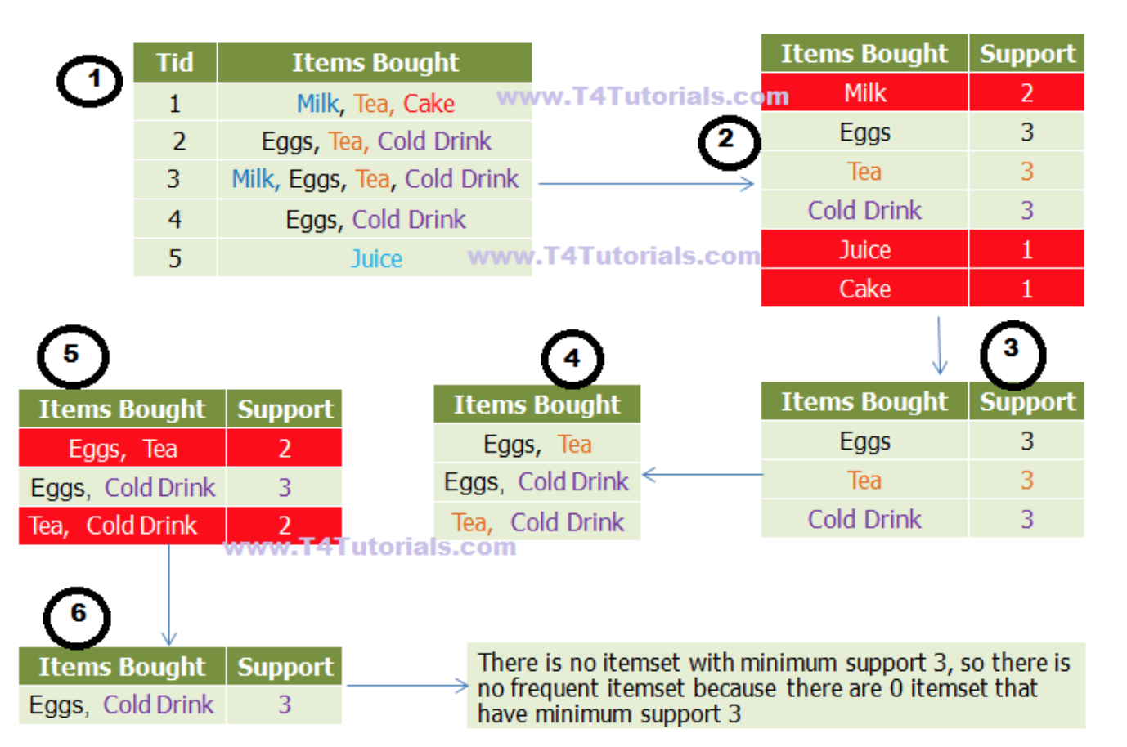
https://t4tutorials.com/apriori-algorithm-in-data-mining-with-examples/
min_support=3

Slide 18
https://t4tutorials.com/apriori-algorithm-in-data-mining-with-examples/
min_support=3

Slide 19
https://t4tutorials.com/apriori-algorithm-in-data-mining-with-examples/
min_support=3

Slide 20
https://t4tutorials.com/apriori-algorithm-in-data-mining-with-examples/
min_support=3

Slide 21
https://t4tutorials.com/apriori-algorithm-in-data-mining-with-examples/
min_support=3

Slide 22
https://t4tutorials.com/apriori-algorithm-in-data-mining-with-examples/
min_support=3

Slide 23
https://t4tutorials.com/apriori-algorithm-in-data-mining-with-examples/
min_support=3

Slide 24
FP-Growth
f
m
f
m
f
f
m
f
https://www.youtube.com/watch?v=gq6nKbye648

Slide 25
FP-Growth
f
m
f
m
f
f
f
f
m
m
m
f
https://www.youtube.com/watch?v=gq6nKbye648

Slide 26
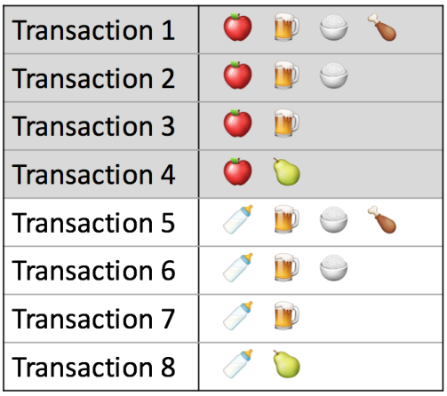
Association Rules & Pattern Evaluation
Support
Confidence
What is the misleading problem of it?
https://www.kdnuggets.com/2016/04/association-rules-apriori-algorithm-tutorial.html

Slide 27
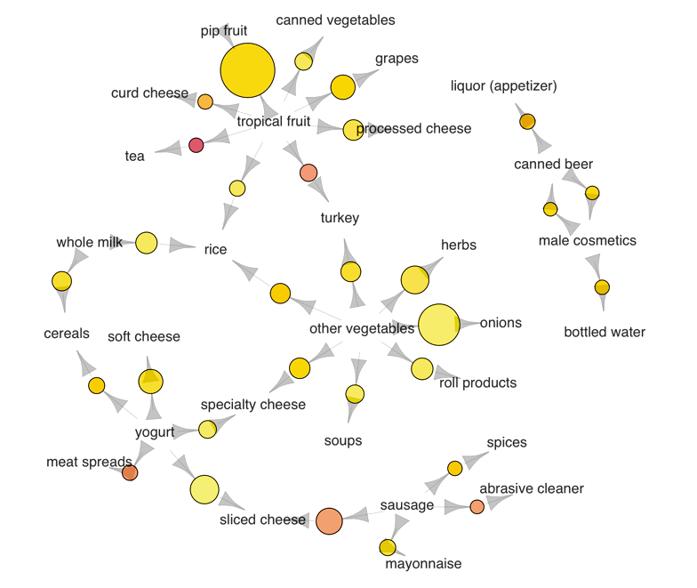
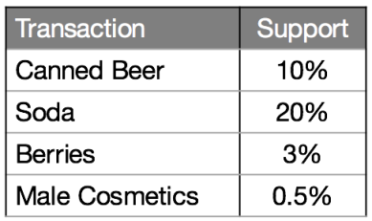
Drawback of the Confidence Measure
The {beer -> soda} rule has the highest confidence at 20%. However, both beer and soda appear frequently across all transactions, so their association could simply be a fluke. This is confirmed by the lift value of {beer -> soda}, which is 1, implying no association between beer and soda.
https://www.kdnuggets.com/2016/04/association-rules-apriori-algorithm-tutorial.html

Slide 28
Drawback of the Confidence Measure
On the other hand, the {beer -> male cosmetics} rule has a low confidence, due to few purchases of male cosmetics in general.
https://www.kdnuggets.com/2016/04/association-rules-apriori-algorithm-tutorial.html

Slide 29
Drawback of the Confidence Measure
However, whenever someone does buy male cosmetics, he is very likely to buy beer as well, as inferred from a high lift value of 2.6. The converse is true for {beer -> berries}. With a lift value below 1, we may conclude that if someone buys berries, he would likely be averse to beer.
https://www.kdnuggets.com/2016/04/association-rules-apriori-algorithm-tutorial.html

Slide 30
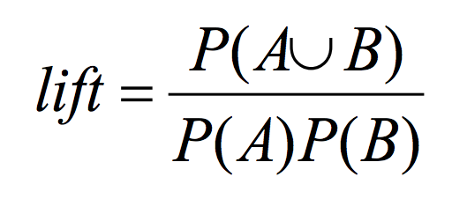
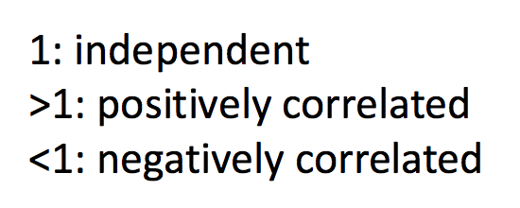
Association Rules & Pattern Evaluation
Lift
https://www.kdnuggets.com/2016/04/association-rules-apriori-algorithm-tutorial.html

Slide 31
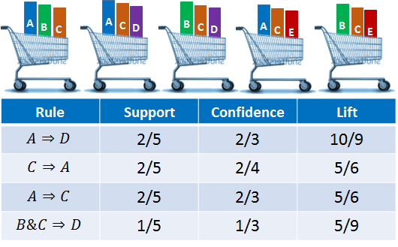
Association Rules & Pattern Evaluation
https://www.kdnuggets.com/2016/04/association-rules-apriori-algorithm-tutorial.html

Slide 32
Association Rules & Pattern Evaluation
https://www.kdnuggets.com/2016/04/association-rules-apriori-algorithm-tutorial.html

Slide 33
Chi-Square Test
Question: Are education level and marital status related?
https://www.spss-tutorials.com/chi-square-independence-test/

Slide 34
Chi-Square Test
Check the contingency table of marital status by education:
https://www.spss-tutorials.com/chi-square-independence-test/

Slide 35
Chi-Square Test
Is marital status related to education level and -if so- how?
https://www.spss-tutorials.com/chi-square-independence-test/

Slide 36
Chi-Square Test
Highly educated respondents → marry more often than less educated
https://www.spss-tutorials.com/chi-square-independence-test/

Slide 37
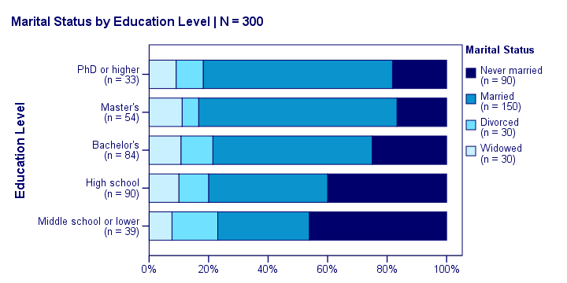
Chi-Square Test
Marital status is clearly associated with education level.
https://www.spss-tutorials.com/chi-square-independence-test/

Slide 38
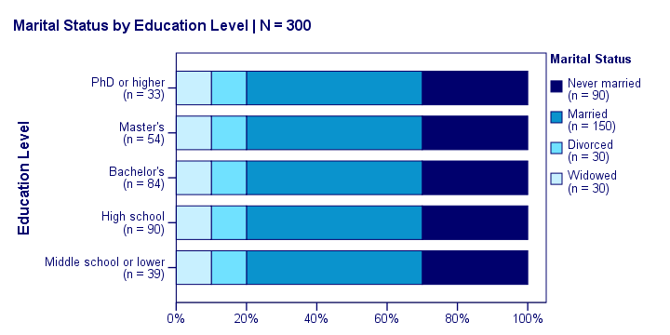
Chi-Square Test
The null hypothesis for a chi-square independence test is that
two categorical variables are independent in some population.
https://www.spss-tutorials.com/chi-square-independence-test/

Slide 39
Chi-Square Test
Statistical independence means that
the frequency distribution of a variable is the same for all levels of some other variable.
https://www.spss-tutorials.com/chi-square-independence-test/

Slide 40
Chi-Square Test
Expected frequencies are
the frequencies we expect in our sample if the null hypothesis holds.
https://www.spss-tutorials.com/chi-square-independence-test/

Slide 41
Chi-Square Test
Assuming independence (null hypothesis)
P(middle,never)=P(middle)P(never)=(39/300)*(90/300)
Expected # of (middle,never) = 300*P(middle,never)=39*90/300=11.7
https://www.spss-tutorials.com/chi-square-independence-test/

Slide 42
Chi-Square Test
Assuming independence,
→ expected frequencies
P(middle,never)=P(middle)P(never)=(39/300)*(90/300)
Expected # of (middle,never) = 300*P(middle,never)=39*90/300=11.7
https://www.spss-tutorials.com/chi-square-independence-test/

Slide 43
Chi-Square Test
Real data
→ observed frequencies:
https://www.spss-tutorials.com/chi-square-independence-test/

Slide 44
Chi-Square Test
Add up the differences for each of the 5*4=20 cells
→ χ2
https://www.spss-tutorials.com/chi-square-independence-test/

Slide 45
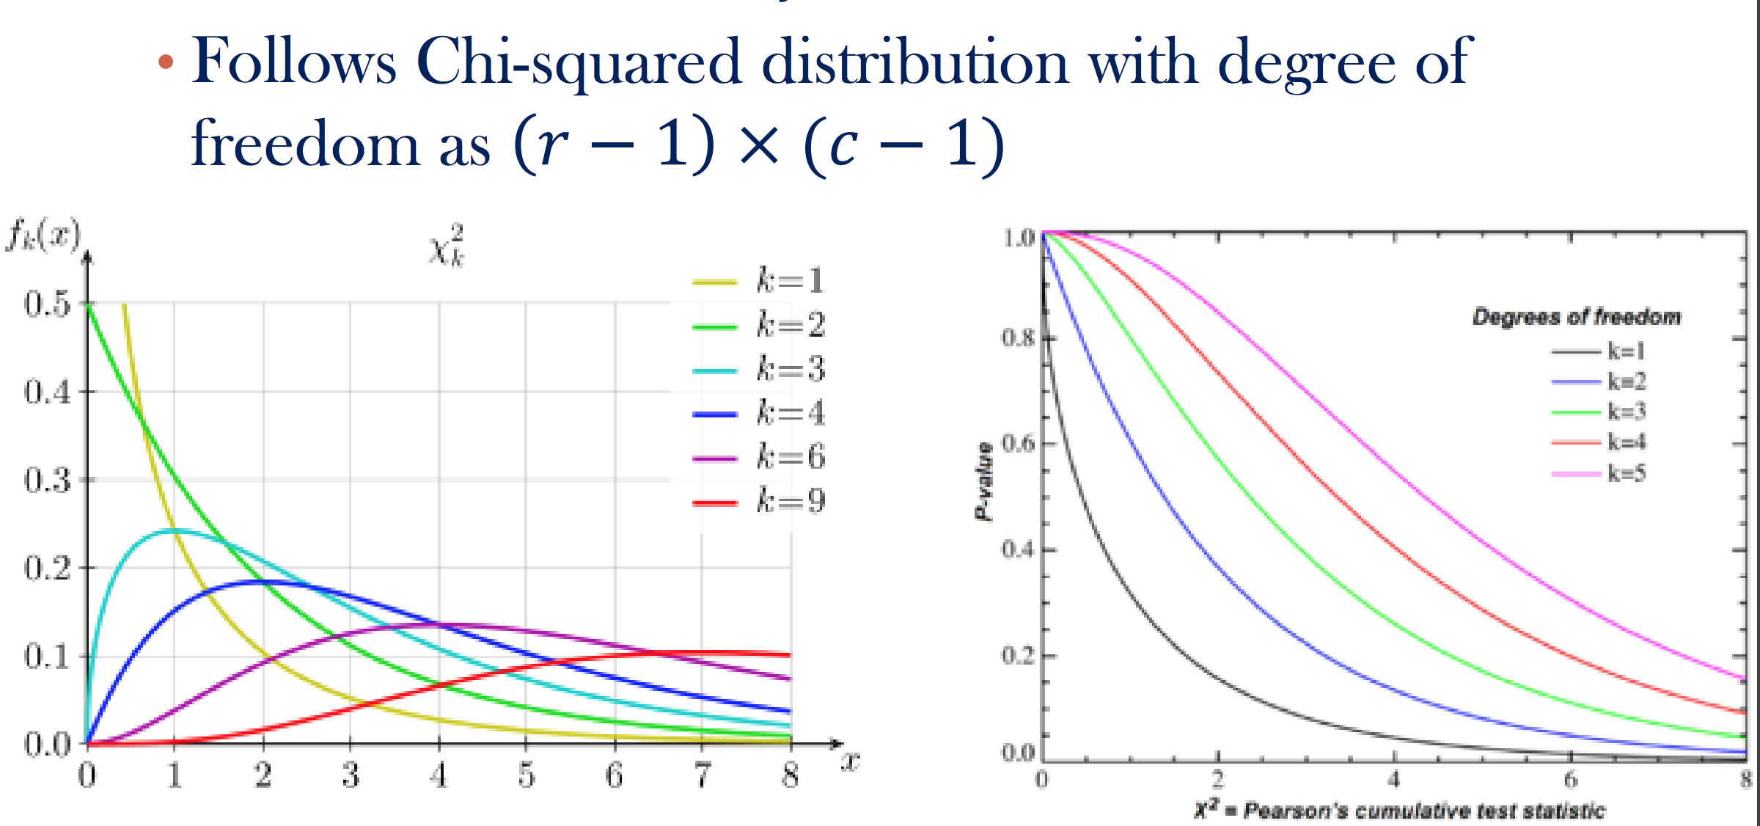
Chi-Square Test
Is χ2=23.57 a large value?
If yes, reject the null hypothesis → A and B are dependent
But how to tell if it is a large value?
χ2
Pearson established it in 1900. See more.
https://www.spss-tutorials.com/chi-square-independence-test/

Slide 46
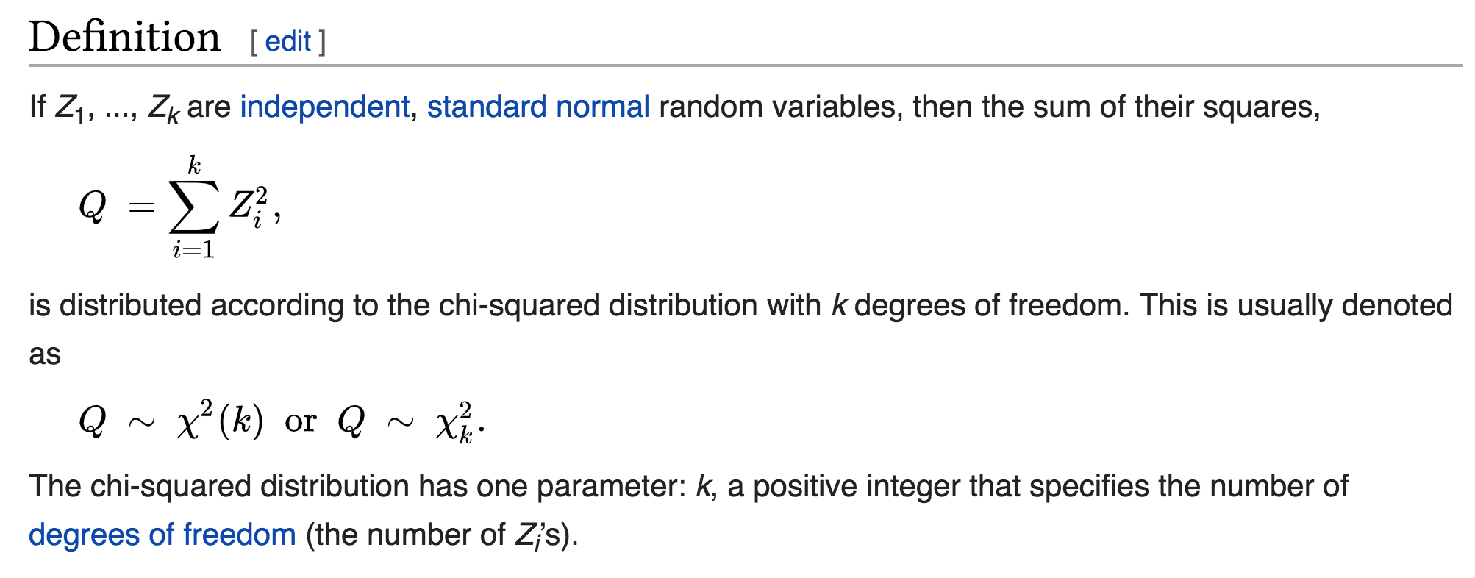
Chi-Square Test
What is a chi-squared distribution?
https://en.wikipedia.org/wiki/Chi-squared_distribution

Slide 47
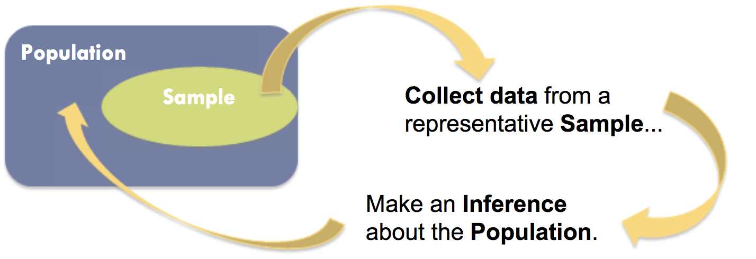
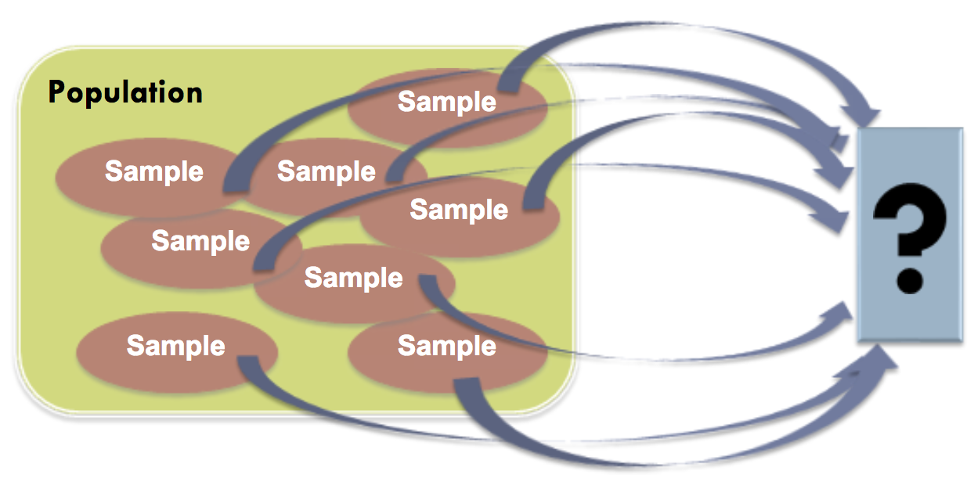
Sampling Distribution vs Population Distribution
https://slideplayer.com/slide/5775066/

Slide 48
Sampling Distribution vs Population Distribution
https://slideplayer.com/slide/5775066/

Slide 49
Sampling Distribution vs Population Distribution
https://slideplayer.com/slide/5775066/

Slide 50
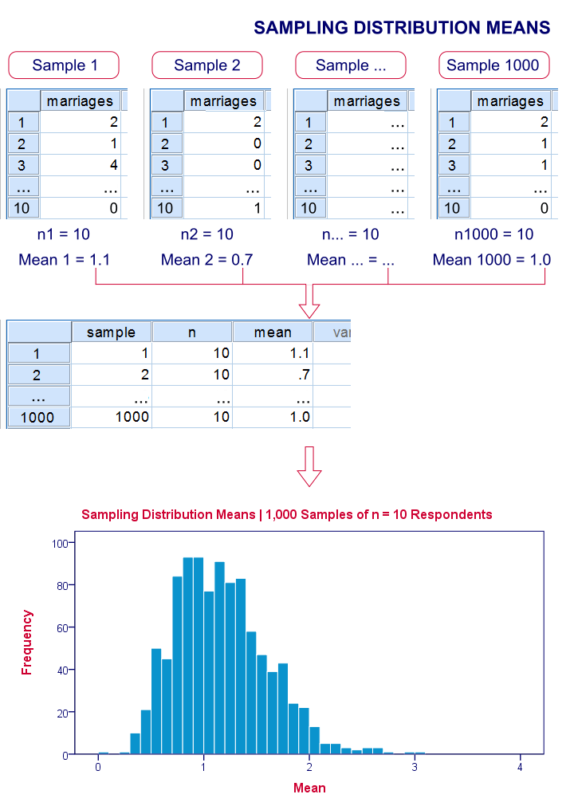
Sample means and sums are always normally distributed (approximately) for reasonable sample sizes, say n > 30. This doesn't depend on whatever population distribution the data values may or may not follow.* This phenomenon is known as the central limit theorem.
https://www.spss-tutorials.com/sampling-distribution-what-is-it/

Slide 51
Chi-Square Test
In this example,
What is the sampling distribution of χ2?
Under what assumptions does the above hold?
https://www.spss-tutorials.com/chi-square-independence-test/

Slide 52
Chi-Square Test
In this example,
What is the sampling distribution of χ2? χ2 follows a χ2 distribution.
Under what assumptions does the above hold? Independent observations, etc.
https://www.spss-tutorials.com/chi-square-independence-test/

Slide 53
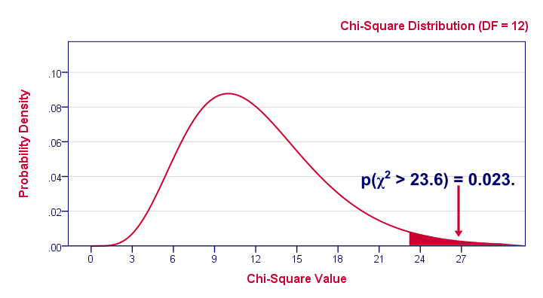
Chi-Square Test
In this example,
How to interpret P(χ2>23.6)=0.023?
The probability of _____ under _____ assumptions is very small, 2.3%.
A small p-value basically means that the data are unlikely under some null hypothesis. A somewhat arbitrary convention is to reject the null hypothesis if p < 0.05.
Should we reject the null hypothesis in this case? Yes!
“An association between education and marital status was observed, χ2(12) = 23.57, p = 0.023.”
Why?
https://www.spss-tutorials.com/chi-square-independence-test/
https://www.spss-tutorials.com/statistical-significance/
Notes:
P-values are the probability of obtaining an effect at least as extreme as the one in your sample data, assuming the truth of the null hypothesis.

Slide 54
Summary: Conceptual Understanding
What are hypothesis testing, p-value, and significance level?
Hypothesis testing is the use of statistics to determine the probability that a given hypothesis is true. The usual process of hypothesis testing consists of four steps.
Formulate the null hypothesis H_0 (commonly, that the observations are the result of pure chance) and the alternative hypothesis H_a (commonly, that the observations show a real effect combined with a component of chance variation).
Identify a test statistic that can be used to assess the truth of the null hypothesis.
Compute the p-value, which is the probability of obtaining an effect at least as extreme as the one in the sample data assuming that the null hypothesis were true. The smaller the p-value, the stronger the evidence against the null hypothesis.
Compare the p-value to an acceptable significance value (level) 𝛼. If p<=𝛼, that the observed effect is statistically significant, the null hypothesis is ruled out, and the alternative hypothesis is valid.
http://mathworld.wolfram.com/HypothesisTesting.html
http://blog.minitab.com/blog/adventures-in-statistics-2/understanding-hypothesis-tests-significance-levels-alpha-and-p-values-in-statistics
http://www.stat.yale.edu/Courses/1997-98/101/sigtest.htm

Slide 55
Summary: Conceptual Questions
In the previous example,
What is the null hypothesis?
What is the test statistics?
What is the p-value?
What is the significance level?
What is the conclusion?

Slide 56
Summary: Conceptual Questions
In the previous example,
What is the null hypothesis? There is no association between the two variables.
What is the test statistics? χ2=23.6
What is the p-value? P(χ2>23.6)=0.023
What is the significance level? 0.05
What is the conclusion? There is an association between the two variables.

Slide 57
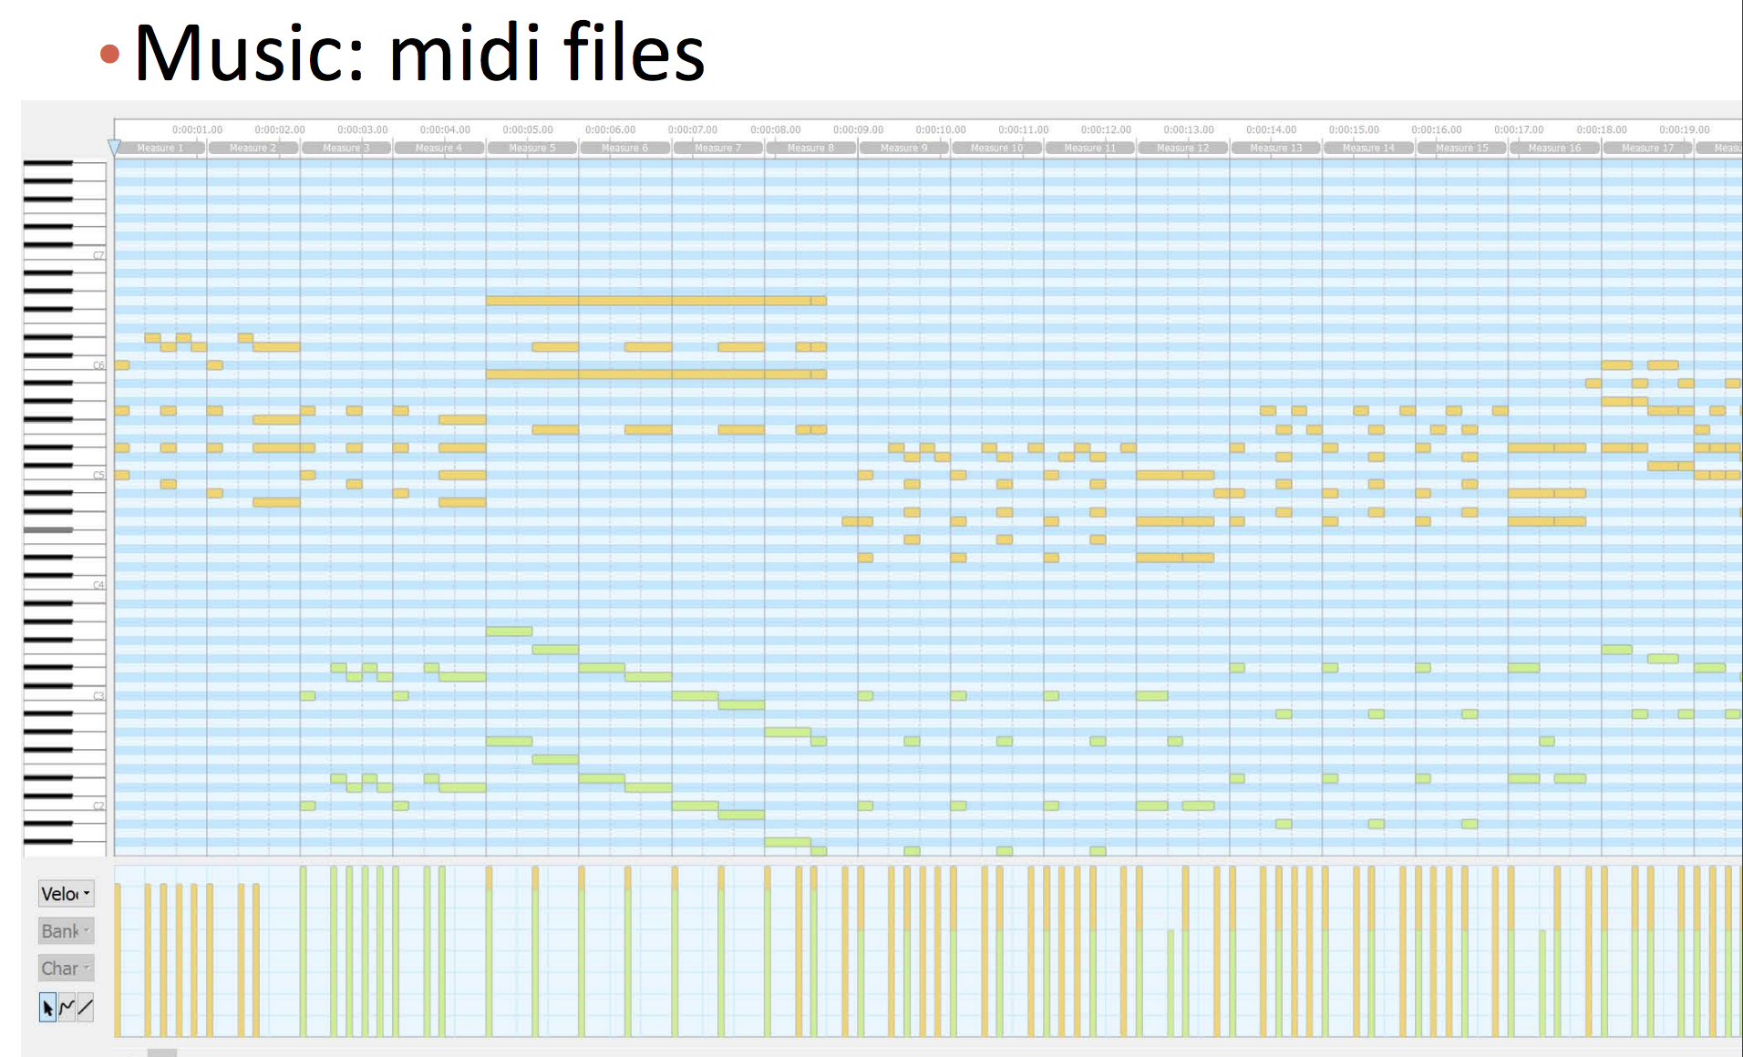
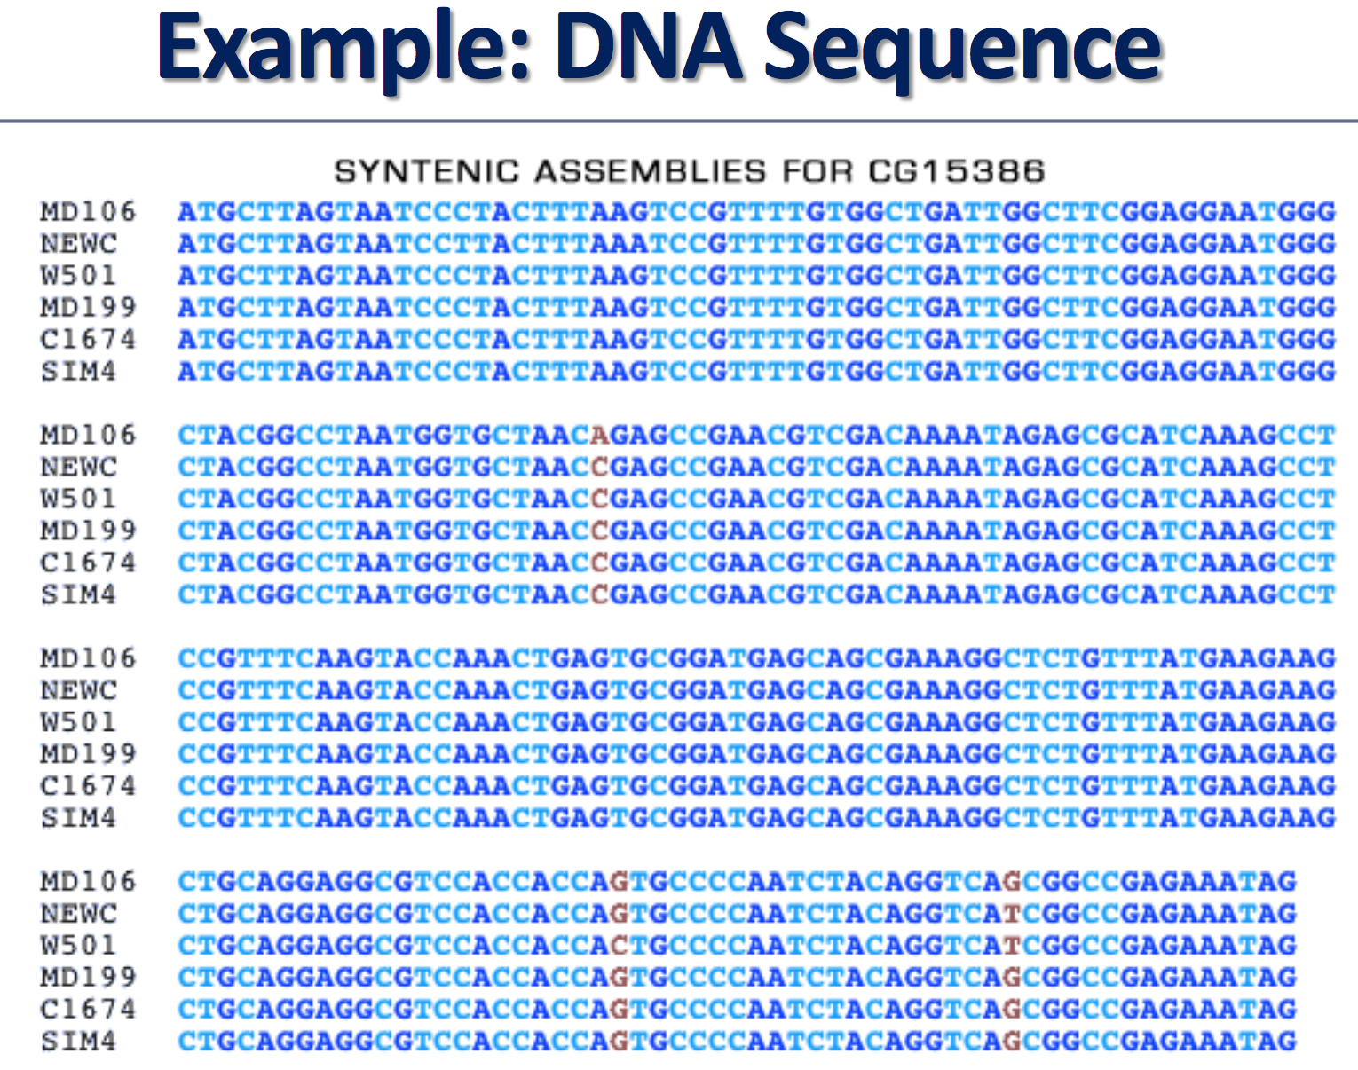
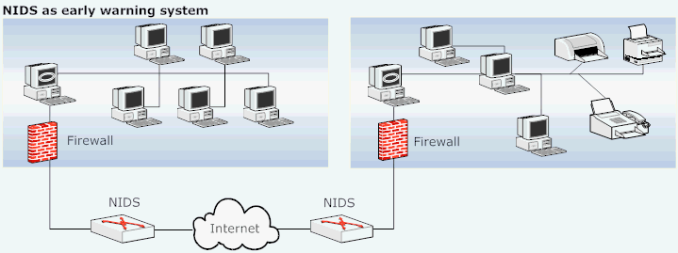
Sequential Pattern Mining: Applications
https://www.cse.wustl.edu/~jain/cse571-07/ftp/ids/index.html#sec2

Slide 58
GSP
https://www.slideshare.net/Krish_ver2/53-mining-sequential-patterns

Slide 59
GSP
https://www.slideshare.net/Krish_ver2/53-mining-sequential-patterns

Slide 60
GSP
https://www.slideshare.net/Krish_ver2/53-mining-sequential-patterns

Slide 61
GSP
https://www.slideshare.net/Krish_ver2/53-mining-sequential-patterns

Slide 62
GSP
https://www.slideshare.net/Krish_ver2/53-mining-sequential-patterns

Slide 63
GSP
https://www.slideshare.net/Krish_ver2/53-mining-sequential-patterns

Slide 64
GSP
https://www.slideshare.net/Krish_ver2/53-mining-sequential-patterns

Slide 65
GSP
https://www.slideshare.net/Krish_ver2/53-mining-sequential-patterns

Slide 66
GSP
https://www.slideshare.net/Krish_ver2/53-mining-sequential-patterns

Slide 67
PrefixSpan
https://fenix.tecnico.ulisboa.pt/downloadFile/1407993358847907/licao_8.pdf

Slide 68
PrefixSpan
https://fenix.tecnico.ulisboa.pt/downloadFile/1407993358847907/licao_8.pdf

Slide 69
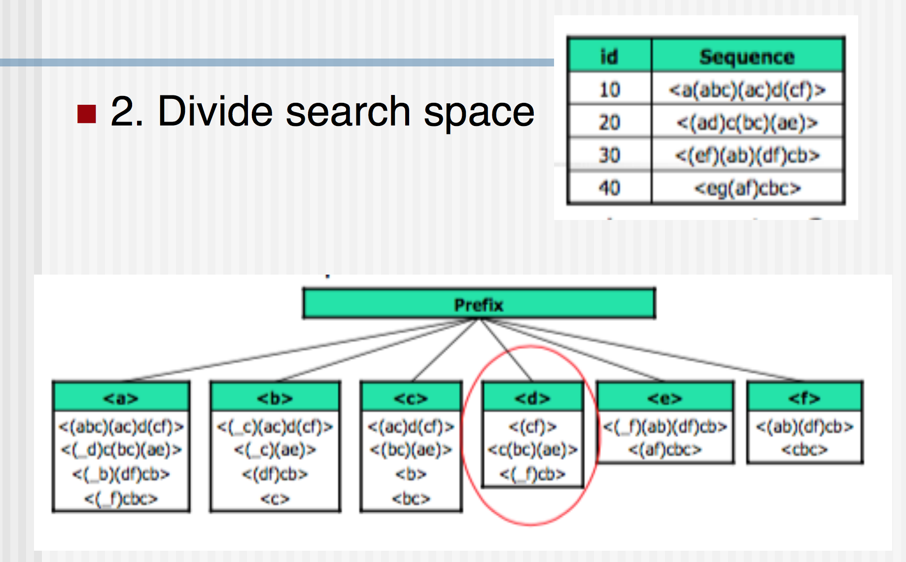
PrefixSpan
https://fenix.tecnico.ulisboa.pt/downloadFile/1407993358847907/licao_8.pdf

Slide 70
PrefixSpan
https://fenix.tecnico.ulisboa.pt/downloadFile/1407993358847907/licao_8.pdf

Slide 71
PrefixSpan
https://fenix.tecnico.ulisboa.pt/downloadFile/1407993358847907/licao_8.pdf

Slide 72
PrefixSpan
https://fenix.tecnico.ulisboa.pt/downloadFile/1407993358847907/licao_8.pdf

Slide 73
PrefixSpan
https://fenix.tecnico.ulisboa.pt/downloadFile/1407993358847907/licao_8.pdf

Slide 74
Thank you!
Q & A

